Slide 1

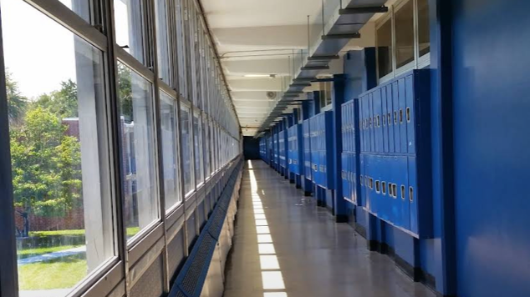
Transitioning from secondary to post secondary
And the Impacts of Poverty on College-Going Behavior

Slide 2

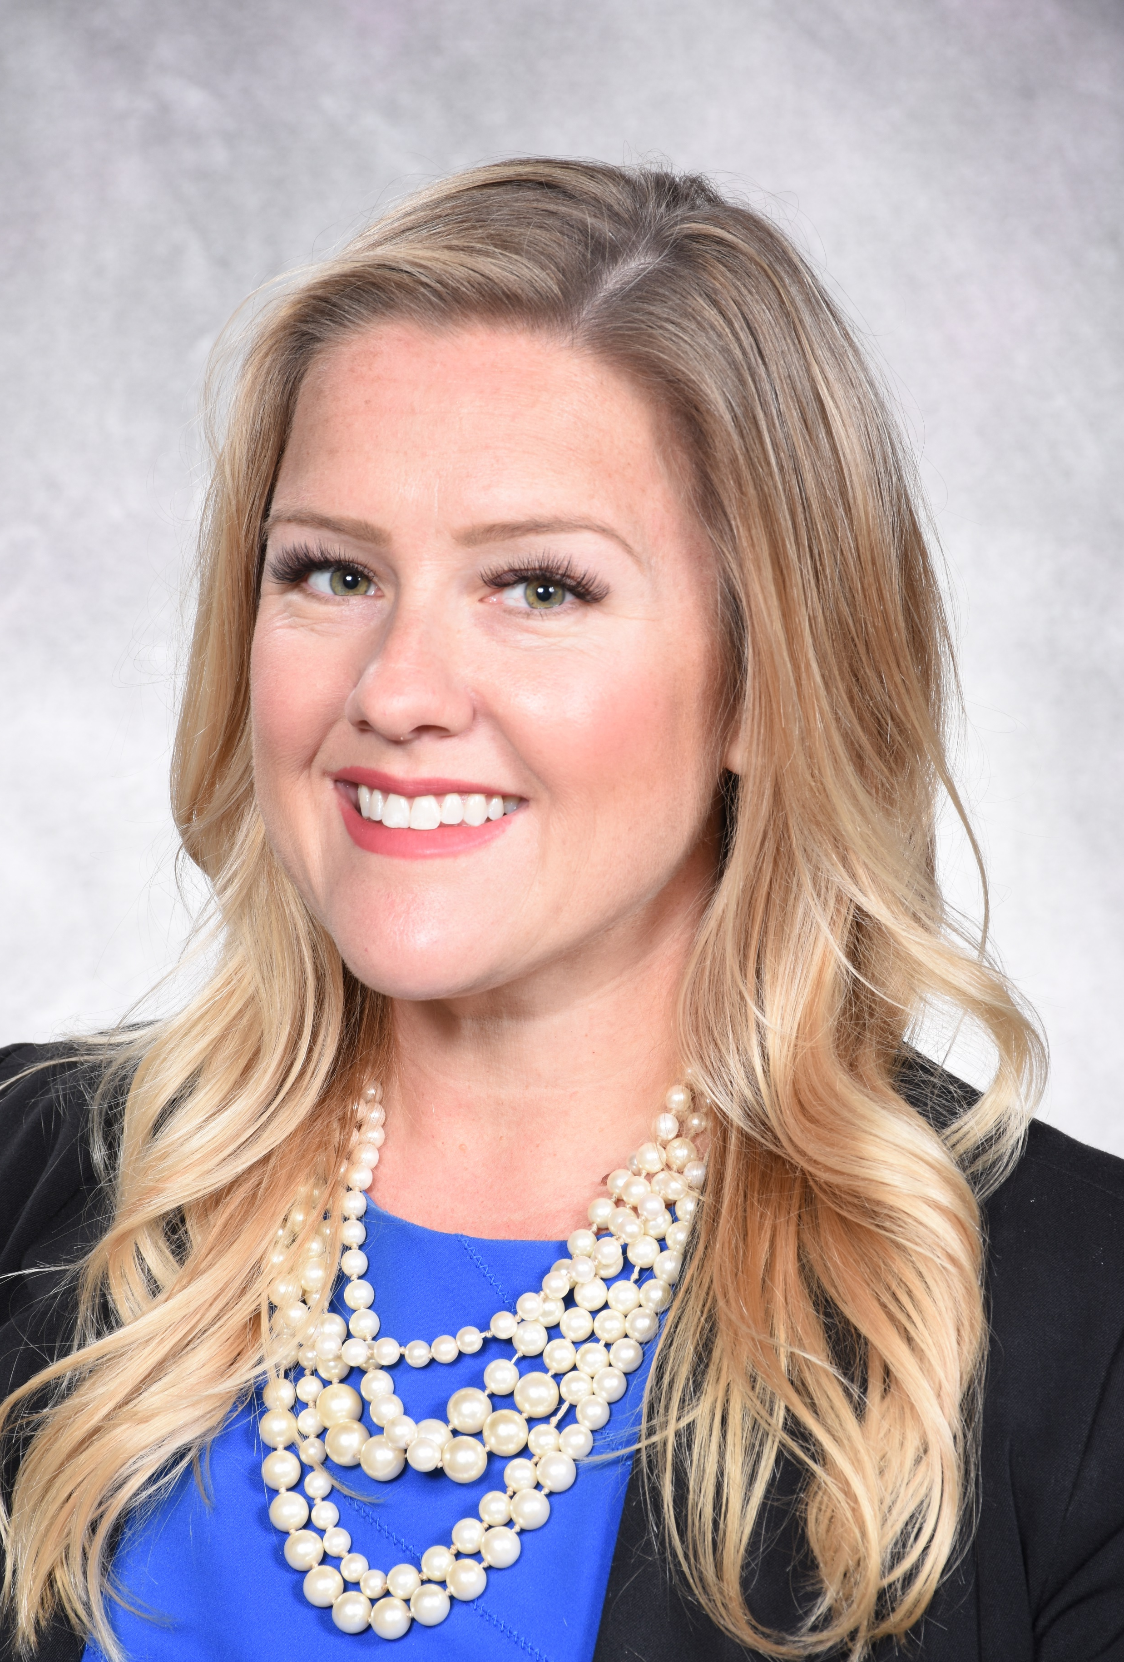



Megan Green
Director of Secondary Curriculum
St. Lucie Public Schools

Slide 3
Session Objectives
Transitioning to College: Identifying Barriers
Examine the Institutional Supports
Understanding the Effects of Poverty
Intentional Practices for Rigorous Learning

Slide 4

Notes:
Turn to a partner – share 3 things about your story. You’ve established a connection – it wasn’t painful – everyone is ok. Think of your faculty. What is stopping them for getting to know the stories of their students?

Slide 5

Title I High Schools
Schools with at least 40% of enrollment are from low-income families are eligible to use Title I funds to operate schoolwide programs
Programs serve all children in the school in order to raise the achievement of the lowest-achieving students.
Additional personnel/ Supplemental Resources that support student learning

Slide 6
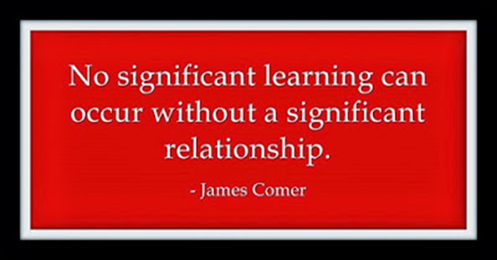
Trifecta of traits
High Poverty
Low Academic Achievement
High Discipline Behaviors

Slide 7

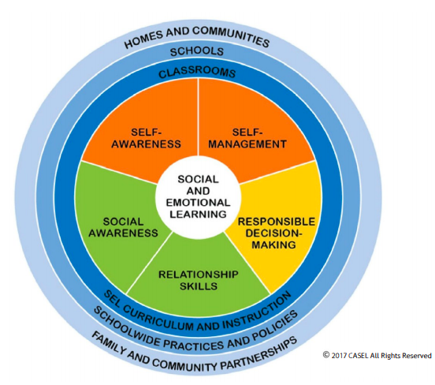
STUDENT SUPPORT
Personnel
High Structure Environment
  Bells
  One Master Schedule
  Common Expectations
The Whole Student
  Social Emotional Learning
Notes:
Educators in K-12 provide the support when gaps exist.
Counseling – food banks, community agencies, child care.
Work with the entire family.

Slide 8

Sel in st. lucie
Social-Emotional Learning Self-Perception
Social Awareness
Emotional Regulation
Student Supports & Environment
Rigorous Expectations
Teacher-Student Relationships
Sense of Belonging
School Climate
School Safety
5 Competencies of SEL
Self-Awareness | Self-Management
Social Awareness | Relationship Skills
Responsible Decision Making
(SLPS SEL DPT, 2021)

Slide 9
Creating the culture trainings for leaders, Faculty, staff
Equity, Diversity, and Bias Training
Mental Health Curriculum and Resources
What’s in a grade?
Supporting the Whole Student: Understanding School Culture Data

Slide 10
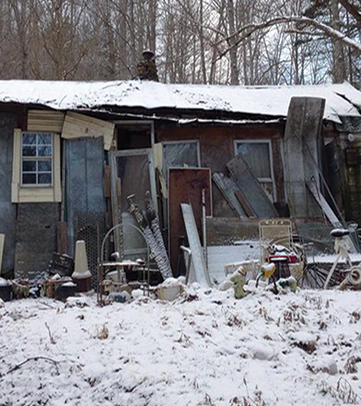
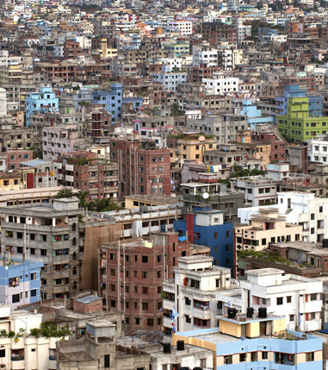
Understanding the Effects of Poverty

Slide 11
Poverty
Defined as a set of resources and how those resources impact your ability to navigate your environment.
  Same definition as wealth
The fewer your resources, the more unstable your reality is.
Poverty by its very nature is an environmental condition, and it tends to destabilize environments.
Environments force behaviors in order to survive and, over time, environments shape thinking.
No single demographic group in the United States “owns” poverty.
(Payne, 2020)

Slide 12
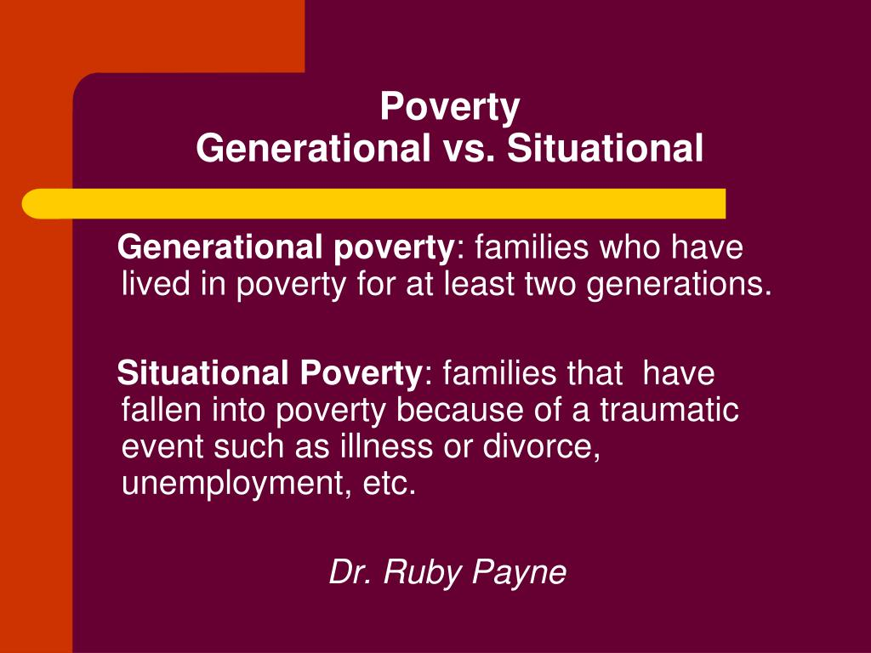

Slide 13
Hidden rules
Individuals in every class have hidden rules
Govern their thinking, assumptions, motivations
When individual doesn’t know the hidden rules (usually from middle class) there is a major disconnect between institution and individual.
(Payne, 2020)

Slide 14
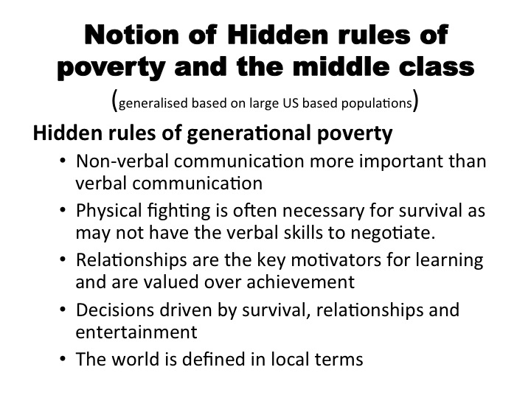
“For our students to be successful, we must understand their hidden rules and teach them the rules that will make them successful at school, at work, and in the community.”
- Dr. Ruby Payne
Notes:
Door is locked to class – what is the driving force to return the next day? Middle – Achievement , Poverty - Relationships
Insert –student who missed appointment b/c cousin needed the car.

Slide 15
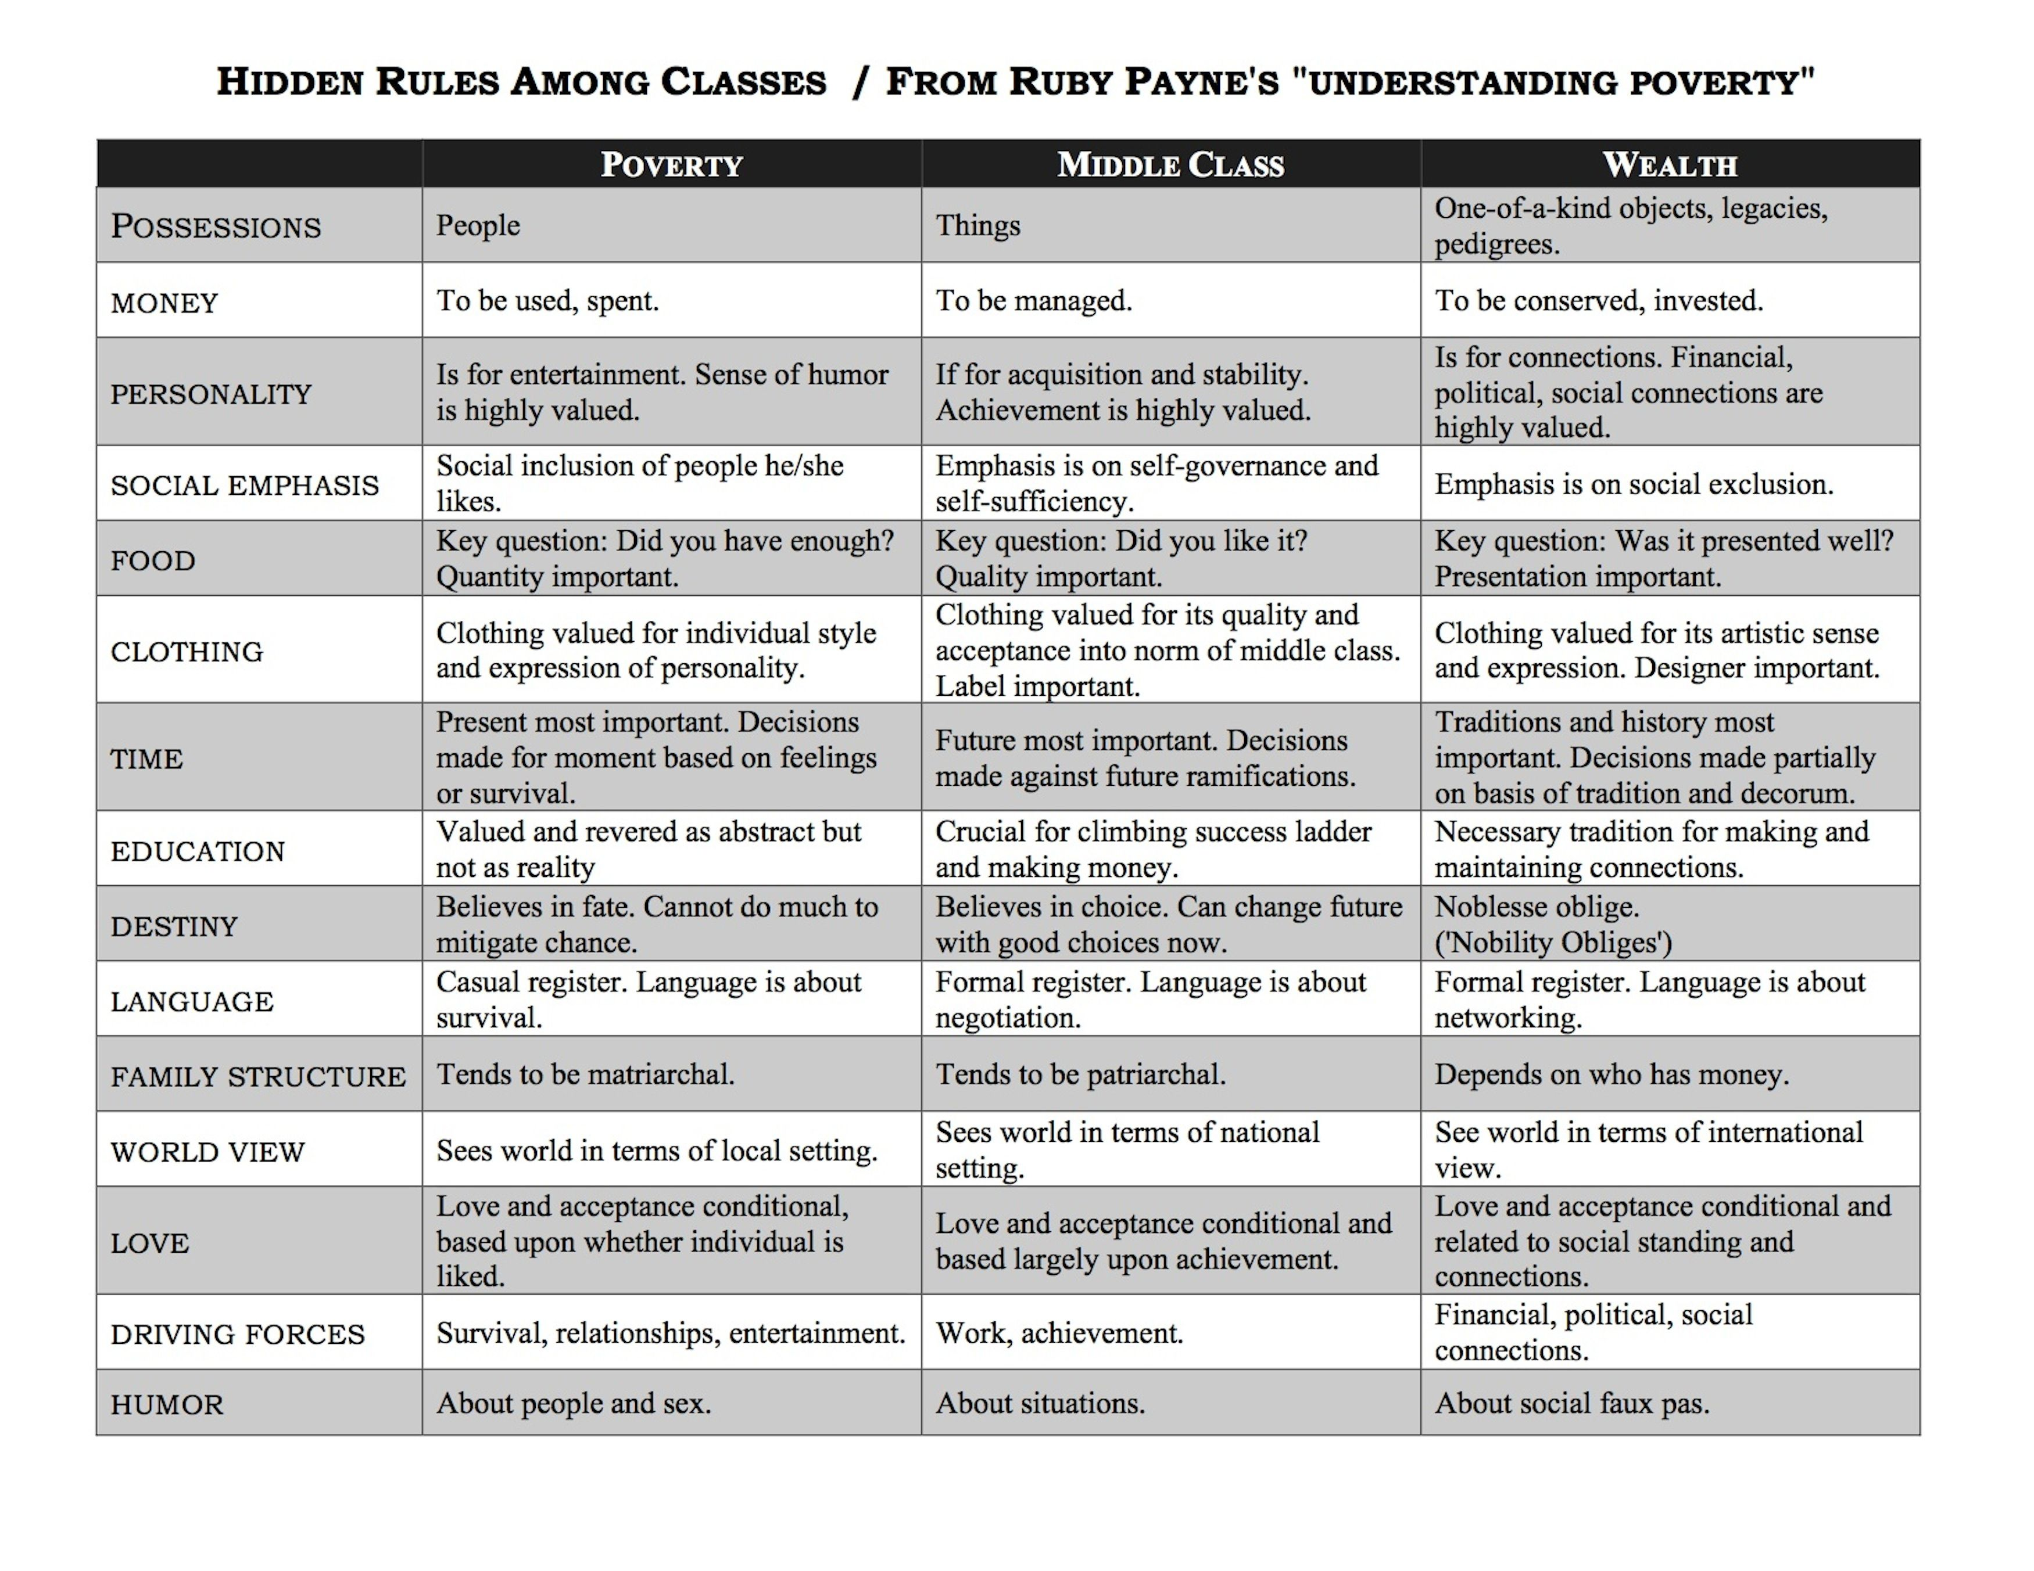
Defend student no matter what they’ve done
Keeping an agenda, grocery list and adhering isn’t observed
Too much education is feared – individual might leave.
For decision making
Notes:
“No-bless oblige”
Meaning – those who are privileges should give back to those less fortunate.
Schools, businesses, are based on middle class rules.
How do you know to be quiet in a library?
How do you know to be quiet when you see a play?
Decorum
My driving force was to graduate college – so I was on time, turned in assignments on time.

Slide 16
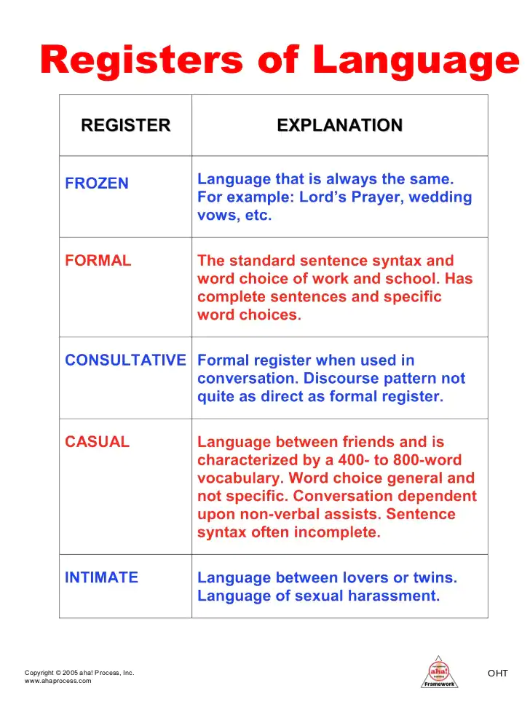
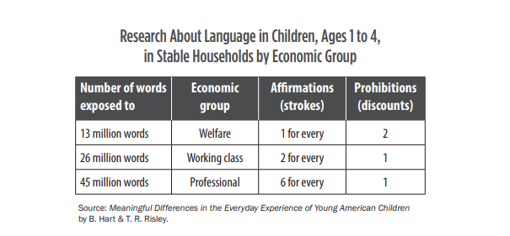
Study found children from educated, professional families – 30 million more words than less educated, welfare families.
Early language exposure predicted receptive spoken language, academic achievement.
Do not have the vocabulary or knowledge for formal register.
Much meaning comes from non-verbal communication

Slide 17
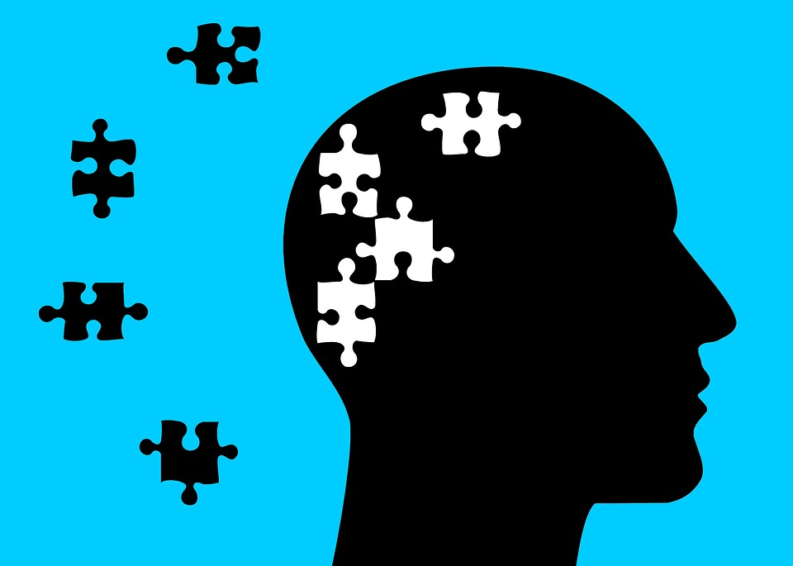
Mental Models
An internal picture of how the world works
Exists below awareness
Are theories in-use, often unexamined
Determine how we act
Can help or interfere with learning
(Payne, 2006)

Slide 18
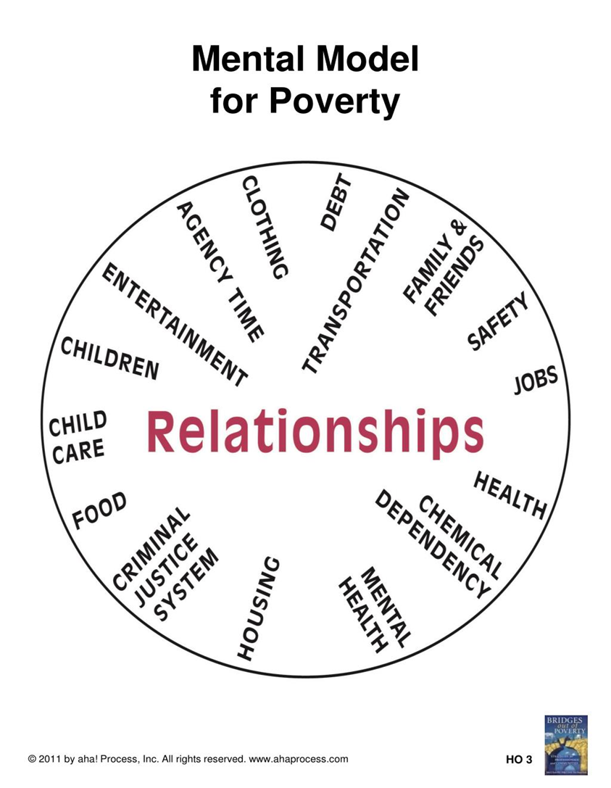
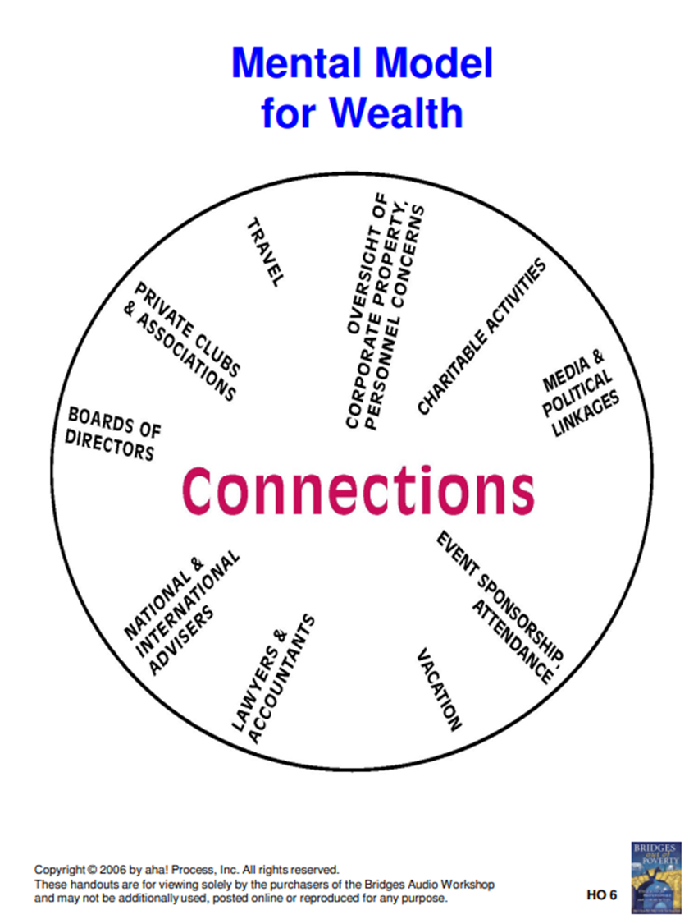
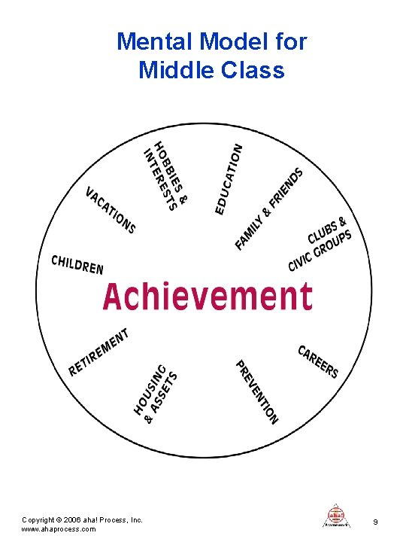
Notes:
Schools, colleges are based on middle class rules.

Slide 19
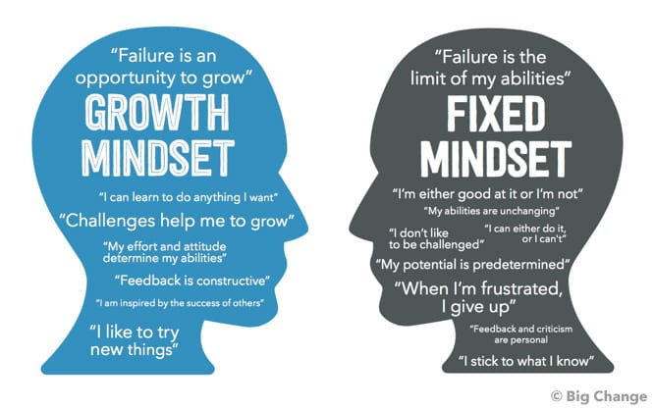
Notes:
My potential is predetermined – poverty.

Slide 20

“When you address the needs of marginalized students, you inherently improve conditions for all students.”
- Dr. V. Wanza

Slide 21

“How can so many students be graduating from high school unprepared to meet their goals for college and careers?”
(TNTP, 2018)
Notes:
TNTP – The New Teacher Project
Focuses on equity in education – in providing resources, trainings, support to school districts.

Slide 22
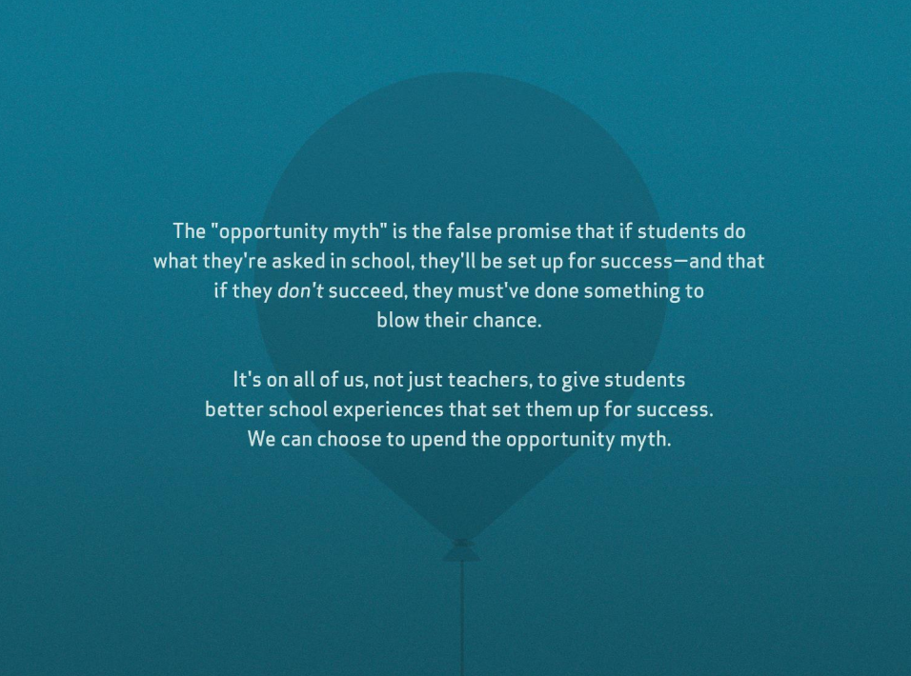
(TNTP, 2018)

Slide 23
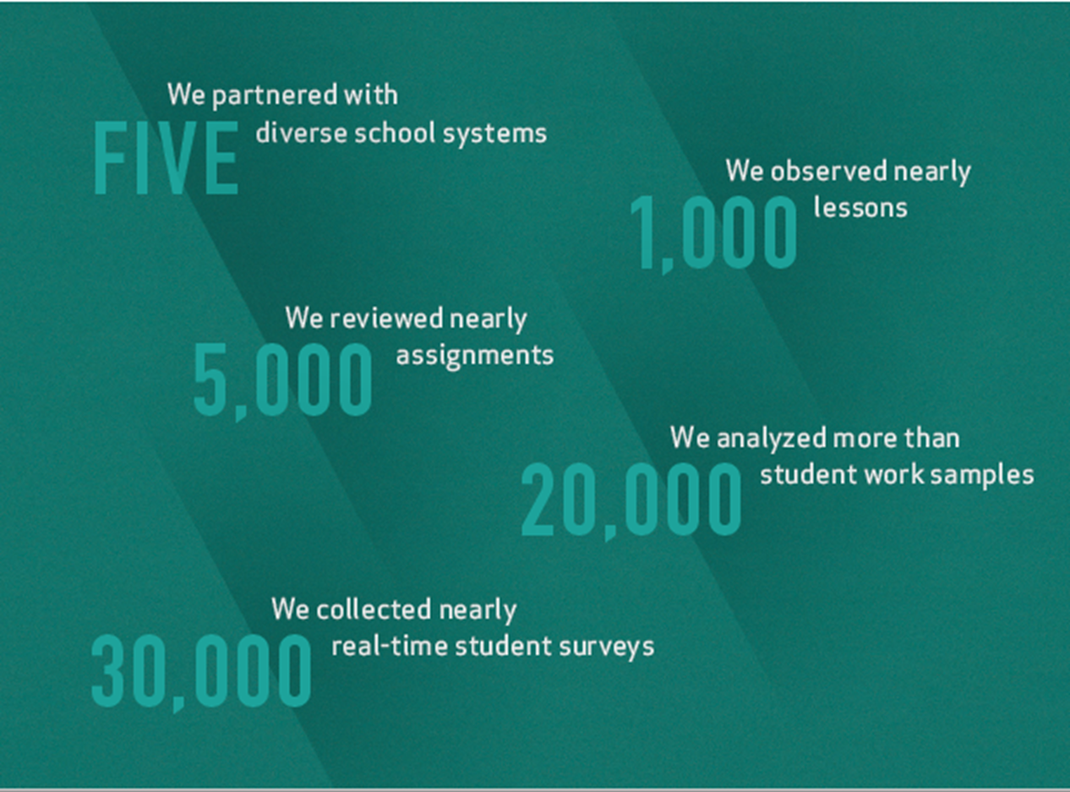
The Opportunity Myth
5 diverse school districts
  Rural
  Urban
  District
  Charter
Observed student experiences inside and out of school setting
Focus on what students were doing in their classes and how they perceived time.
Student aspirations
  Were schools preparing them or letting them down?
(TNTP, 2018)

Slide 24
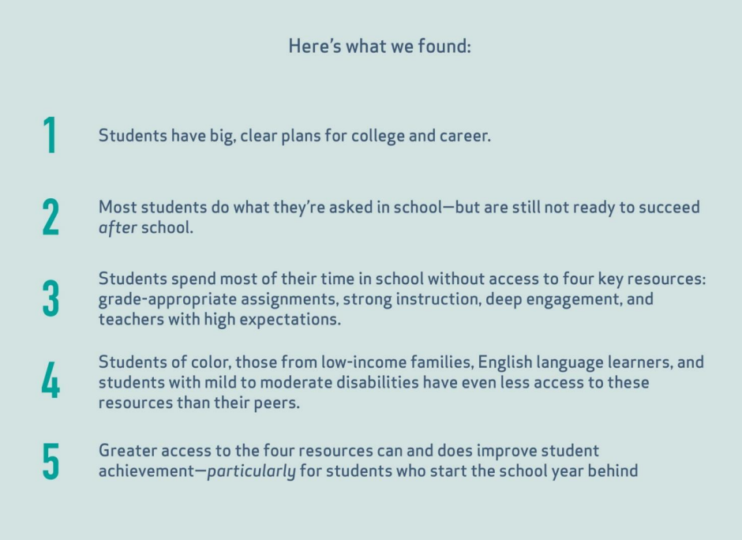
94% of students surveyed aspired to attend college
70% had career goals that required at least a college degree
(TNTP, 2018)

Slide 25
Intentional practices to close the gap…
Curriculum that is on-grade level, rigorous, standards-based
Curriculum that is culturally relevant and engaging
Enrollment in advanced level coursework
IB
Dual enrollment
AP
AICE
SAT/ACT School Day
1:1 Computer Access – Technology integration

Slide 26

Transitioning to College: Barriers for Students

Slide 27

Transitioning to College
If a student enters a Community College without the tools needed to study, plan, and manage their time to be successful, how does the college community support them?
“Poverty traps people in the tyranny of the moment,
making it … difficult to attend to abstract information
or plan for the future—the very things needed to build
toward the attainment of a college degree.”
–Philip DeVol

Slide 28

Transitioning to college
Barriers for students
Money
  Can I balance working, life and going to school?
  Can I afford working, life and going to school?
  Which will I give up if it becomes too hard?
Structure
  High School = High Structure
  College = High Flexibility
    Requires self-discipline
    Intrinsic Motivation
    Does extrinsic motivation exist?
Notes:
Met with a barrier
Human reaction – website not functioning as it should. Natural reaction is to give up.

Slide 29
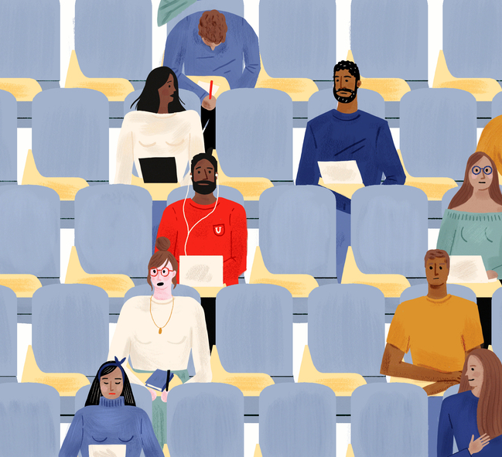
Transitioning to college
Barriers for students
Content
  Low-level readers
    What “safety nets exist in college?
  Relevance/Engagement
    Culturally relevant
    Dry?

Slide 30
Things to consider…
“If you choose, you have chosen…”
Time
If a student is late for class, what are the ramifications?
Relationships
What are the expectations of faculty and staff to form relationships with students on campus?
Resources
Who is responsible for connecting students with resources when needed?
No Tardies

Slide 31
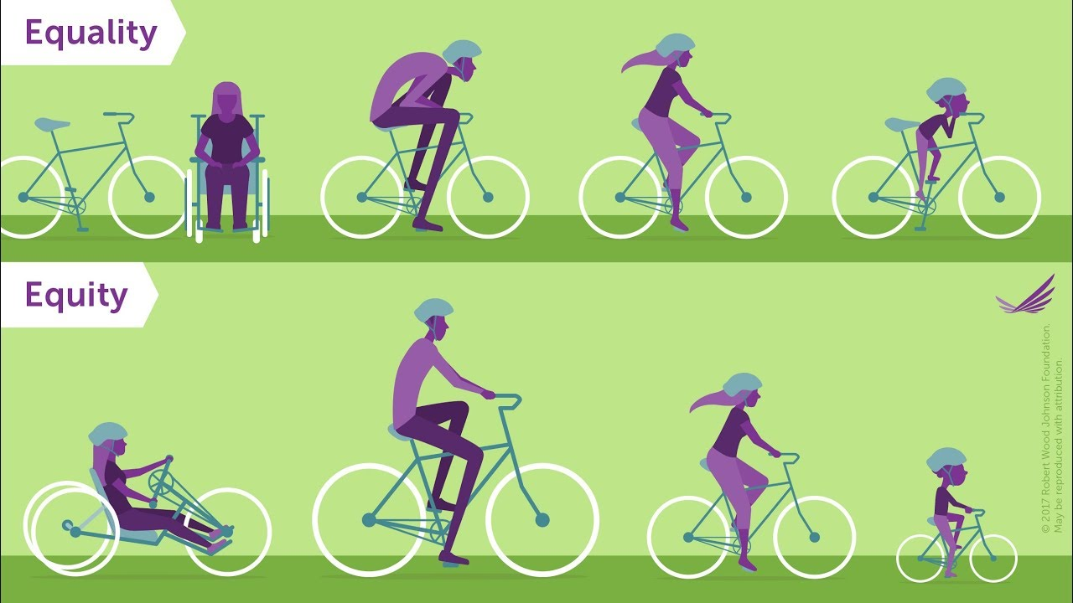
What do YOU need to be successful?

Slide 32
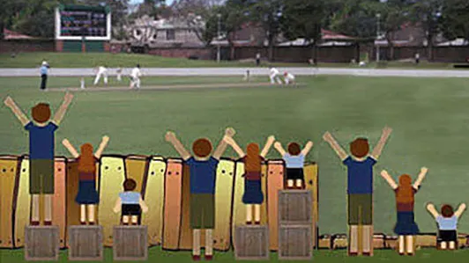
What are some of the fences that exist for students and how can we work to remove them?
List 3 and share with a partner

Slide 33
Examine the supports of the institution…
Procedures in place to remove barriers for students
By understanding the Hidden Rules
Teach Time Management
What practices work against the goals of the institution?
Promote Relationships
Examine the details
What practices disenfranchise students?

Slide 34

Things to consider in the onboarding process…
Interest Surveys on or before Day 1
  Do you have internet access at home?
  Do you have a computer (not just a phone with data)?
  How many people live in your home?
  How many people work in your home?
  Do you have a car? If not, what is your means of transportation?
Mentor Matches – Promote Relationships
  Doesn’t need to be 1:1
    Meet over emails, zoom, coffee
    Create a support network for new students, freshmen
    Work-study opportunities for sophomores
Notes:
Many high school students were successful because of the support they received. How can you create similar support systems on your campus?

Slide 35

Notes:
It only takes one to create change.

Slide 36
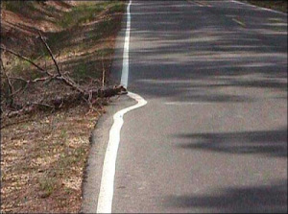

Systems of support
Less of this
“It’s on the website…”
“Ask your advisor”
More of this
Get to know students – fast
Listen to the student voice, focus groups
Opportunities for faculty and advisors to have crosstalk
Provide students with one-stop answers, limit the barriers

Slide 37



How can the daily actions of the institution support the goals?
How can you be the one for students?
Notes:
The goal of high school is graduation.

Slide 38



