Slide 1
Impact of Senate Bill 366: Increasing Opportunities for Students through Alternative Placement Methods
Carrie Henderson, Ph.D. ​
Executive Vice Chancellor, Division of Florida Colleges​
Carrie.Henderson@fldoe.org

Slide 2
Agenda
Activity
Background
Senate Bill 366
Discussion

Slide 3
Emergency Order 2020-EO-02
Waived the common placement testing requirement for developmental education course placement and dual enrollment eligibility for summer/fall 2020.
Removed the provision in (s.) 1007.263(1), F.S., that requires that admissions counseling “must use tests to measure achievement of college-level communication and computation competencies by students entering college credit programs.”
Allowed for institutions to consider alternative methods in addition to, in combination with or in lieu of, common placement tests.

Slide 4
Communications Placement Methods Reported by Colleges
 | ENC1101 | ENC1101C
PSAT | 430+
FSA - ELA Score | Level 4+
Senior high school English course | B or higher | C (70-79%)
HS English 4 | B or higher
HS English 4 Honors | B or higher
English AP | B or higher
English IB | B or higher
English Cambridge/AICE | B or higher

Slide 5
Mathematics Placement Methods Reported by Colleges
 | MATX033 | MGFX107 | MACX105 | MACX105C | MGFX106 | STAX023
PSAT Math | 480+ | 480+ 530+ | 530+ | 480+ | 480+ 530+ | 530+
FSA - Mathematics | Level 4-5 | Level 4-5 |  | Level 4-5 | Level 4-5
EOC Math – Algebra 1 or Geo | Level 4-5 | Level 4-5 |  | Level 4-5 | Level 4-5
HS Algebra | B or better | B or better
HS Algebra I honors | B or better | B or better
HS Algebra II | B or better | B or better | A or better B or better |  | B or better | B or better
HS Algebra II Honors |  | B or better | A or better B or better |  | B or better | B or better
HS Algebra III | B or better |  | A or better B or better |  | B or better | B or better
HS Pre-Calculus | B or better | B or better | A or better B or better |  | B or better | B or better
HS Calculus | B or better | B or better | B or better |  | B or better | B or better
HS Trig |  |  | B or better
AP Math | B or better | B or better | B or better |  | B or better | B or better
IB Math | B or better | B or better | B or better |  | B or better | B or better
Cambridge/AICE Math | B or better | B or better | B or better |  | B or better | B or better

Slide 6
Alternative Methods
Voluntary Ad Hoc Data Collection
Participating institutions collected student-level placement information in summer and fall 2020.
The student-level files were submitted by participating institutions in early spring 2021.
  Student-level files contained demographic data and placement method.
Using the files submitted, the division is linking each student to course taking records and enrollment patterns.
The Division analyzed the data collected with a focus on dual enrollment eligibility placement methods and first-term outcomes.

Slide 7
Research Questions
What are the characteristics of dual enrollment students who were placed using alternative methods as compared to those students placed using an approved placement test?
How do students, deemed eligible to participate in dual enrollment using alternative methods, perform in first-term coursework compared to students whose eligibility was determined using common placement tests?

Slide 8
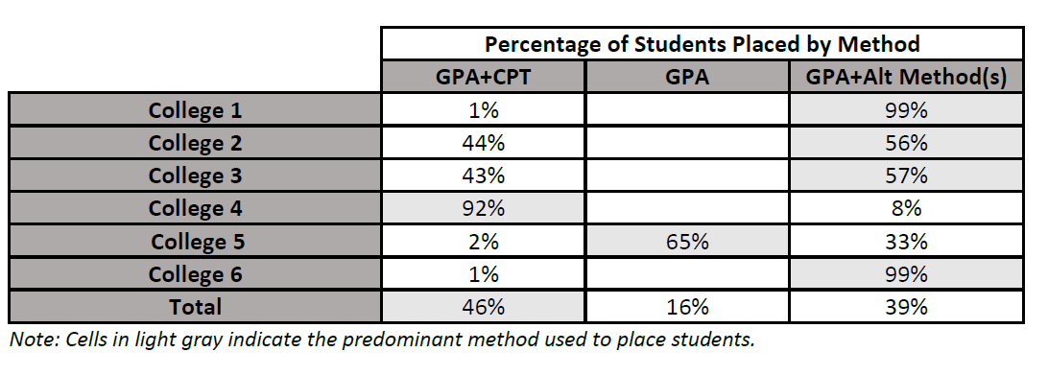
Placement Methods
System-wide, the method used to place the highest percentage of dual enrollment students was high school GPA and a common placement test (GPA+CPT), which was used by all six institutions to place 46 percent of students followed by 39 percent of students placed using GPA and an alternative method.

Slide 9
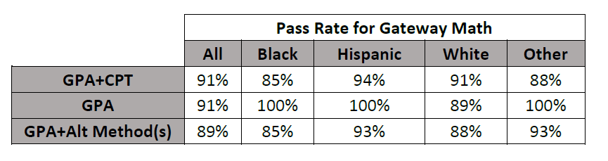
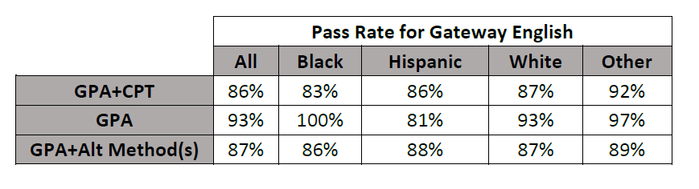
Pass Rates by Race/Ethnicity

Slide 10
Limitations
This was a voluntary ad hoc data collection, so the findings are not representative of all FCS institutions.
The temporary suspension of the common placement testing requirement allowed for institutions to use alternative methods, but did not prescribe which methods should be used.
Due to the flexibility given to institutions during this data collection, it is important to note that one or two institutions may contribute more to certain outcomes due to the institutions' size and enrollment.
Student performance in fall 2020 may have been affected by COVID-19, so the conditions for the comparison vary.

Slide 11
Key Takeaways
Overall, the temporary suspension of the common placement test requirement did not appear to negatively affect students in their first-term general education, gateway math and gateway English courses.
Black, Hispanic and FRL students placed with GPA+Alt Method(s) had the same pass rate or one percentage point less than those placed with GPA+CPT in gateway math and had higher pass rates than those placed with GPA+CPT in gateway English.

Slide 12
Alternative Methods to Assess College-Level Computation and Communication
SB 366 amends multiple Florida statutes to expand the mechanisms institutions may use to assess readiness for college-level work. In addition to identifying approved common placement tests, SB 366 requires the SBE to adopt rules to develop and implement alternative methods for assessing communication and computation skills.
  College Credit Admissions Counseling: SB 366 amends s. 1007.263, F.S., to add alternative methods for measuring achievement in college-level computation and communication for admissions counseling in college credit programs.

Slide 13
Alternative Methods to Assess College-Level Computation and Communication (Continued)
  College Credit Dual Enrollment Eligibility: SB 366 amends s. 1007.271, F.S., revising eligibility requirements to specify that students must demonstrate achievement in college-level communication and computation as provided in s. 1008.30, F.S. In effect, this revision allows approved alternative methods to be used in eligibility determinations. The usage of alternative methods includes public, private and home education students. ​
  Developmental Education and Meta-Majors: SB 366 amends s. 1008.30, F.S., authorizing FCS institutions to use alternative methods to assess student readiness as it relates to meta-majors and developmental education placement.

Slide 14
Process for Identifying Alternative Methods
The Division of Florida Colleges (DFC) held a webinar on August 19 on the process by which institutions could submit alternative methods for consideration by SBE.
Recommendations were due on September 8.
The DFC compiled and is currently in the process of analyzing the identified recommendations in collaboration with stakeholders.
Total of 60 unduplicated recommendations in three groups.
  High school courses
  Standardized assessments
  In-house instruments/flow-charts

Slide 15
Meetings with Stakeholders
McCann Associates
The Division of Accountability, Research and Measurement (ARM)
The Division of Public Schools (DPS)
The Florida Association for Student Success (FASS) Board
The English for Academic Purposes (EAP) Consortium of Florida
Statewide Mathematics Council

Slide 16
Timeline for Implementation and Next Steps
FDOE will engage in rule development in fall 2021 to further involve institutions in the identification of possible alternative methods.
The DFC anticipates holding a rule workshop in mid-November.
By January 31, 2022, the SBOE will adopt rules to develop and implement alternative methods for assessing the basic communication and computation skills.
Once the rule is effective, FDOE will provide additional technical assistance and guidance.
After that point, FCS institutions may need to update existing policies and/or create new policies related to admissions counseling, dual enrollment eligibility, developmental education placement and meta-major advising.

Slide 17
Discussion
What are the greatest benefits from implementing alternative methods?
What are some challenges related to implementing alternative methods? How might institutions mitigate those challenges?
Are institutions considering using alternative methods in lieu of common placement tests? Or as a multiple measure?

Slide 18
Q&A
Notes:
SWITCH SLIDES

Slide 19
Links to Resources
DFC Memorandum: Recommendations for Alternative Methods to Assess College Readiness and Survey Template (PDF)
Statewide email: Webinar Materials - Alternative Methods Recommendations Submission Process (PDF)
Presentation: Alternative Methods (PDF)
Ad Hoc Alternative Methods Data Collections Study Findings (PDF)
Survey Template (Word)

Slide 20
Contact
Carrie Henderson, Ph.D. ​
Executive Vice Chancellor​
Division of Florida Colleges​
Carrie.Henderson@fldoe.org ​
850-245-9903​

