Slide 1
Reimagining Education and Career Help Act (House Bill 1507) and Onboarding in Workforce Education Programs
Carrie Henderson, Ph.D.
Executive Vice Chancellor, Division of Florida Colleges
Carrie.Henderson@fldoe.org

Slide 2
Agenda
Activity
Guided Pathways Model
House Bill 1507
Discussion

Slide 3

The Student Experience at a “Cafeteria Model” College
Goes back to part-time, 52 credits in 5 years, of which 34 count toward the A.A. degree
Doesn’t meet SAP, temporarily loses financial aid
Begins taking 18 credit hours to catch up
Struggles with additional math and science courses
Told by advisor that most earned credits won’t transfer
First-Generation Student
Childcare costs too burdensome, stops out for a semester
Re-enrolls in spring, courses needed not available/offered at times student needs
Changes to A.A. Program of Study with intent to transfer
Confused by FAFSA,
family can’t help
Self-advises, takes course not in Program of Study
Declares A.S. Program of Study, takes wrong math track
Begins Gen. Ed
Delays college entry, gets part-time job
Student misplaced using traditional placement test, would have benefited from placement based on high school GPA
Placed into Dev. Ed., required to enroll in 4 semesters of Dev. Ed. courses (part-time)
Loses job, enrolls full-time with an undecided major
Misses financial aid deadline, enrolls part-time
Source: Adapted from Guilford Technical Community College

Slide 4

The Student Experience at a Guided Pathways College
Clear program map guides student’s course taking
Student’s progress is monitored and support is provided when needed
Courses are available when student needs them for completion
Student has opportunities to apply learning through WBL
Student on-boards and receives advising and career planning services

Slide 5
Sample Student Intersection with Resources
WIOA
Supplemen-tal Nutrition Assistance Program (SNAP)
Transporta-tion
Health care
Temporary Assistance for Needy Families (TANF)
Child care assistance
Housing Assistance
Transitional services

Slide 6
Discussion
What are current institutional procedures for connecting students with public benefits and support services?
At what point in the student’s pathway are they made aware of these types of resources?
How many times does an institution “hand-off” the student to another individual or office? What does that hand-off look like?

Slide 7
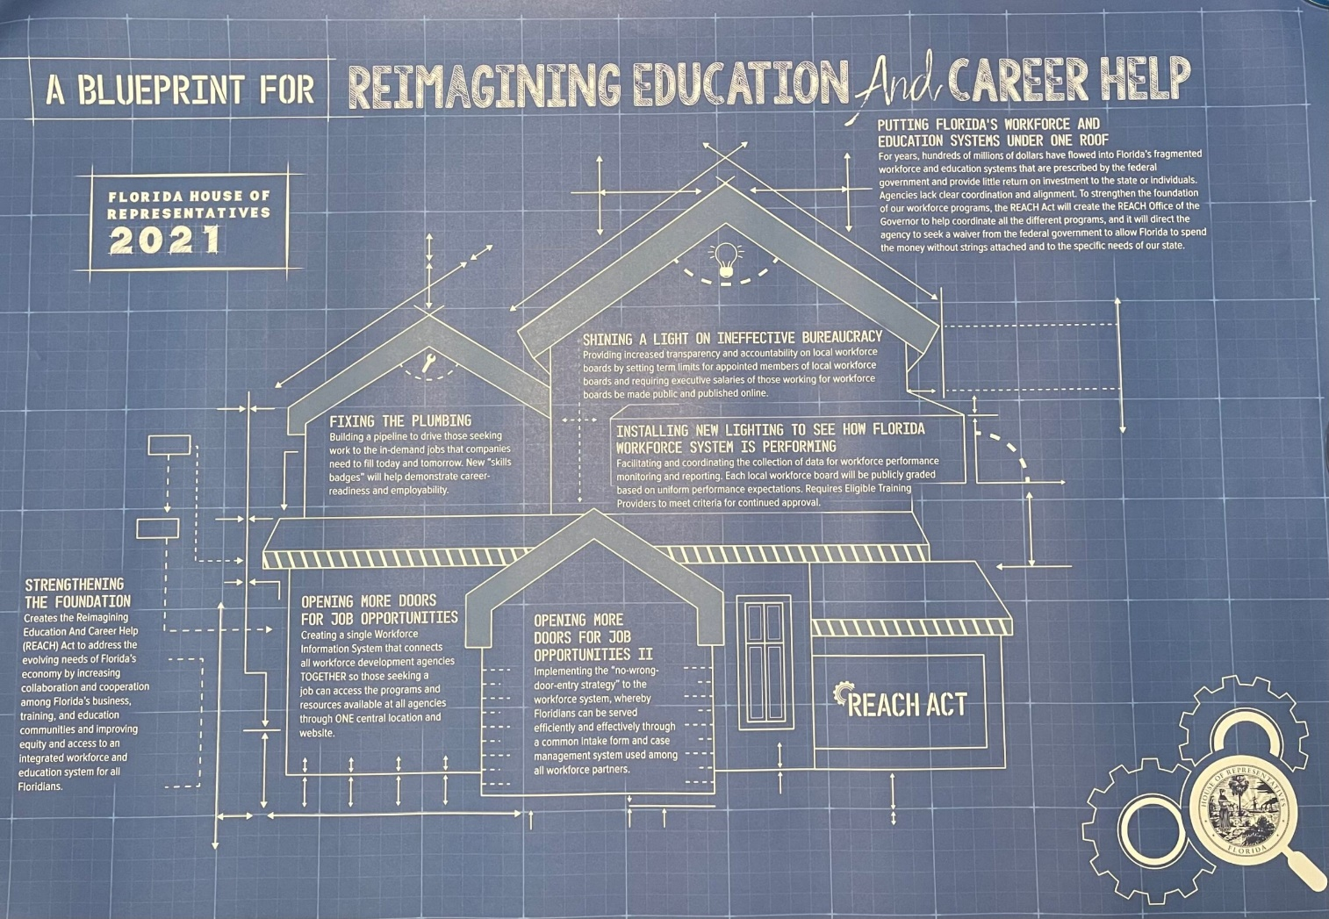
HB 1507

Slide 8
Reimagining the Workforce Development System (WDS)
The following key concepts were identified as promoting a truly aligned and seamless service delivery of workforce services:
  Systemic collaboration of key workforce system partners to take a comprehensive approach to assessing and addressing customer needs and removing barriers to employment;
  Integrated service delivery that provides seamless and comprehensive services to customers;
  Shared data for effective decision making and enhanced data collection and analysis to support program operations;
  Leveraged resources across the programs; and
  Improved employment and training outcomes through stronger connections between the training offered through the workforce system and the training needed by employers.
Source: House of Representatives Staff Analysis (2021), CS/HB 1507

Slide 9
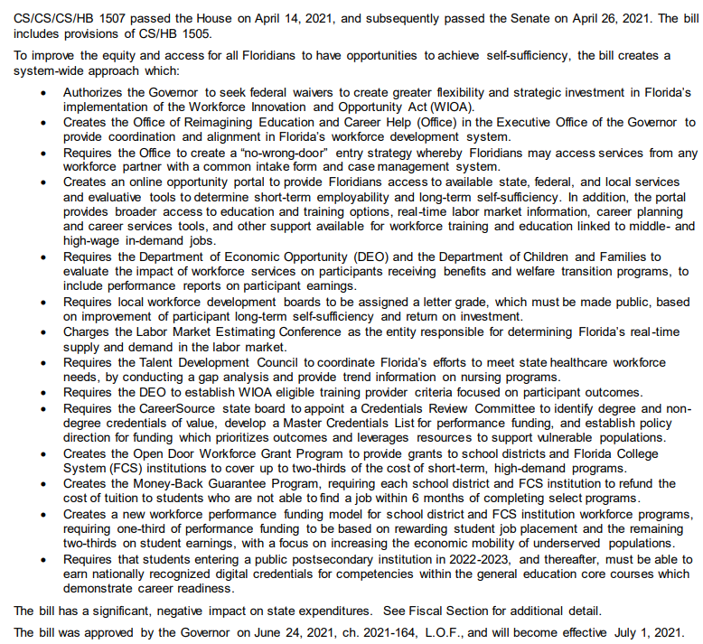
HB 1507 – The Fine Print
Source: House of Representatives Staff Analysis (2021), CS/HB 1507

Slide 10
Key Definitions
Workforce development system: entities and activities that contribute to Florida’s talent pipeline system through education, training and support services that prepare individuals for employment or career advancement.
  The definition specifies the entities that are responsible for oversight or conducting those activities such as CareerSource, LWDB, One-Stop Centers, the DEO, the DOE and the Department of Children and Families.
Source: House of Representatives Staff Analysis (2021), CS/HB 1507

Slide 11
Key Definitions
Workforce education region: areas of the state identified by the DOE, in collaboration with the DEO, to maximize resource allocation by combining two or more sources of funding to integrate education and training in order to improve access to credentials of value for participants in adult education programs.
Source: House of Representatives Staff Analysis (2021), CS/HB 1507

Slide 12
Key Definitions
Workforce related program: a program operated, delivered, or enabled, in whole or in part, by a state or local entity using federal funds or state appropriations to offer incentives, funding, support or guidance for any of the following purposes:
  Job training;
  Attainment of a credential of value as identified by the Credentials Review Committee;
  Attainment of a postsecondary degree or credential;
  The provision of other types of employment assistance; or
  Any other program that has, at least in part, the goal of securing employment or better employment for an individual and receives federal funds or a state appropriation.
Source: House of Representatives Staff Analysis (2021), CS/HB 1507

Slide 13
Reimagining Education and Career Help Act
To create greater alignment among Florida’s WDS for the delivery of programs suited for the 21st century which are focused on equity and efficiency, the bill creates the Reimagining Education and Career Help Act (REACH Act).
The REACH Act serves to address the evolving needs of Florida’s economy by increasing the level of collaboration and cooperation among state businesses and education communities while improving training and providing for equity and access to a more integrated workforce and education system for Florida.
To facilitate alignment and coordination of entities responsible for Florida’s WDS, the bill creates the Office of Reimagining Education and Career Help (REACH Office) in the Executive Office of the Governor.
Source: House of Representatives Staff Analysis (2021), CS/HB 1507

Slide 14
No-Wrong-Door Entry Strategy
The bill requires the REACH Office to improve equity and access to the myriad of state and federally funded workforce related programs offered across different entities by creating a no-wrong-door entry strategy whereby a Floridian must not be required to visit multiple locations when seeking access to education and workforce training. In creating the no-wrong-door strategy, the office is required to do the following:
  Develop a training course to cross-train all staff within Florida’s WDS on workforce related programs, including how to use an integrated case management system, develop an individual employment plan, conduct a comprehensive needs assessment, pre-certify individuals for workforce related programs and on any other activities to reinforce the no-wrong-door-entry strategy;
  Coordinate and facilitate a common intake form and case management system for use by workforce related programs to minimize duplicate data entry.
Source: House of Representatives Staff Analysis (2021), CS/HB 1507

Slide 15
No-Wrong-Door Entry Strategy Continued
In creating the no-wrong-door strategy, the office is required to do the following:
  Coordinate and facilitate a MOU between the DEO and the DCF to permit Supplemental Nutrition Assistance Program (SNAP) and TANF clients to pre-certify for WIOA training services without having to physically visit a one-stop center;
  Oversee the performance evaluation of workforce related programs and services for participants receiving family self-sufficiency benefits and in welfare transition programs; and
  Identify other state and federal programs that serve individuals with significant barriers to employment as demonstrated by low placement, employment and earnings rates and identify strategies to increase the utilization of such programs by LWDBs.
Source: House of Representatives Staff Analysis (2021), CS/HB 1507

Slide 16
Workforce Opportunity Portal
The portal provides the public with more effective access to available federal, state and local services and a system-wide, global view of workforce related program data across various programs through actionable qualitative and quantitative information. The portal will serve as an important tool for Floridian’s looking to reskill or retrain for the workforce.
The workforce opportunity portal will assist Floridians as they:
  Explore and identify career opportunities.
  Identify in-demand jobs and associated earning potential.
  Identify the skills and credentials needed for specific jobs.
  Access a broad array of federal, state and local workforce related programs.
Source: House of Representatives Staff Analysis (2021), CS/HB 1507

Slide 17
Workforce Opportunity Portal (Continued)
The workforce opportunity portal will assist Floridians as they:
  Determine the quality of workforce related programs offered by public postsecondary educational institutions and public and private training providers, based on employment, wages, continued education, student loan debt, and receipt of public assistance by graduates of workforce, certificate or degree programs.
  Identify opportunities and resources to support individuals along their career pathway.
  Provide information to help individuals understand their potential earnings through paid employment and cope with the loss of public assistance as they progress through career pathways toward self-sufficiency.
  Map the timing and magnitude of the loss of public assistance for in-demand occupations across the state to help individuals visualize how their incomes will increase over time as they move toward self-sufficiency.
Source: House of Representatives Staff Analysis (2021), CS/HB 1507

Slide 18
Discussion
What systems do you currently use for student intake and case management? How might a statewide solution benefit your institution’s ability to serve students?
In advising students into workforce programs, are data about program outcomes – specifically job placement and wage data – involved in informing students to select a program?
  How do you advise when a prospective student is interested in a program with barriers to employment (low placement, low earnings, minimal job openings)?
  Do you have specific goals for improving economic outcomes for students of color, low-income students and first-generation students? How do these goals inform advising practices in workforce programs?

Slide 19
Q&A

Slide 20
Contact
Carrie Henderson, Ph.D.
Executive Vice Chancellor
Division of Florida Colleges
Carrie.Henderson@fldoe.org
850-245-9903

