Slide 1
How community colleges are using guided pathways to personalize student support
Hana Lahr, CCRC
Florida Pathways Institute
October 19-20, 2021

Slide 2



Overview
Why focus on program onboarding?
Why personalized support matters during onboarding
Reimagining a more personalized program onboarding experience

Slide 3
Why focus on program onboarding?

Slide 4
Program onboarding sets students up for success.
Onboarding is the process of helping students select, enter, and gain experience in a program of study. This process starts as soon as students apply and is not complete until students have chosen a program, built an educational plan, and taken and passed program gateway courses, which can take up to a year.
A program of study prepares students to secure or advance in a job and/or transfer with no excess credits in the student’s field of interest.

Slide 5
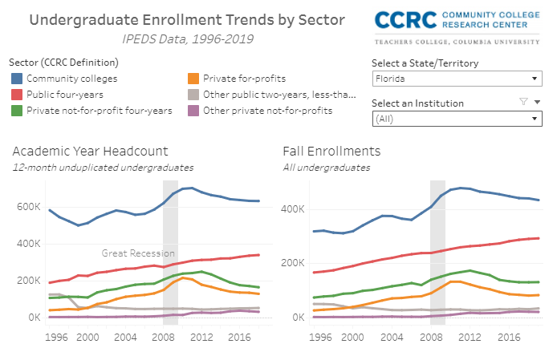
Let’s look at Florida’s postsecondary enrollment trends
https://public.tableau.com/app/profile/john.fink/viz/UndergraduateEnrollmentTrendsbySector/Summary

Slide 6
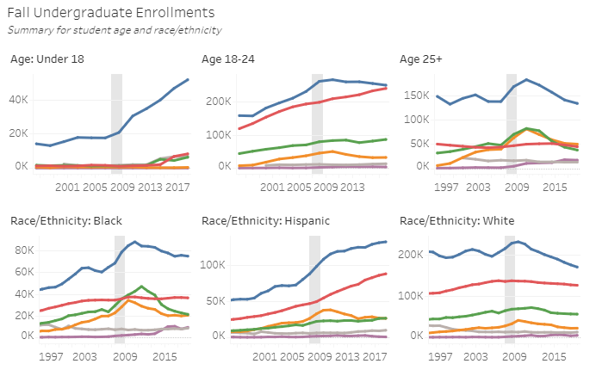
…and enrollments disaggregated by age and race
https://public.tableau.com/app/profile/john.fink/viz/UndergraduateEnrollmentTrendsbySector/Summary

Slide 7
Students’ early experiences play a critical role in their likelihood of completing.
10-40%
45-55%
40%
of community college students are lost between application and the first day of classes
of community college starters leave higher education by their second year
of community college students nationally complete any credential in 6 years

Slide 8
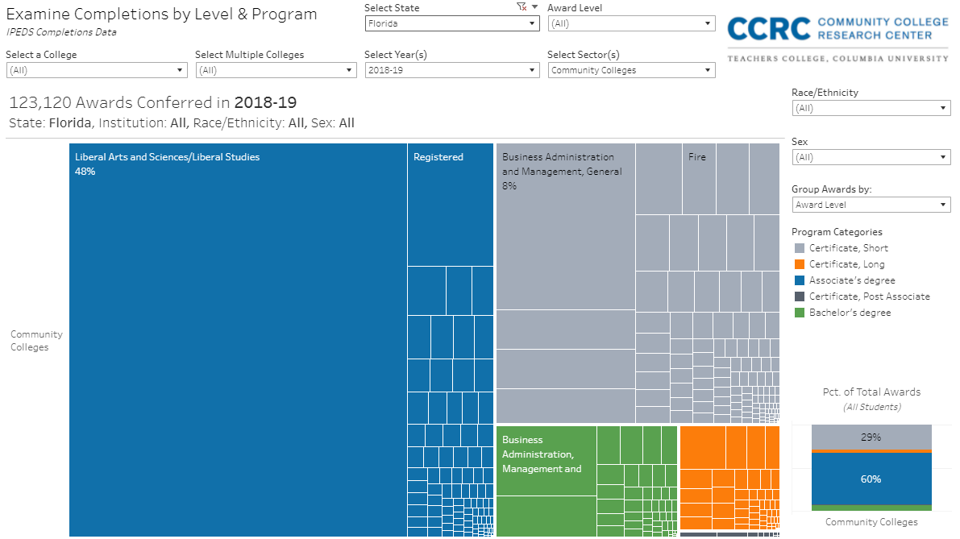
Are the programs our students are completing clearly aligned with good jobs and transfer in students’ fields of interest?

Slide 9
When you consider your fall 2021 new students...
What percentage of students are in liberal arts/AA programs?
What percentage of students aren’t in any program? (including dual enrollment, non-credit, continuing education, adult basic education, undecided)
How much do you know about your students’ goals and how can the college set them up for their next steps?

Slide 10
Being in a program from the start makes it more likely for a student to maintain enrollment at the college into year two, and to complete their program…however, many CC students are not in programs.

Slide 11
Discuss: What support for choosing your major do you wish you had in college?

Slide 12
Why personalized support matters during onboarding

Slide 13




Ask
Connect
Inspire
Plan

Slide 14




ACIP provides a framework for scaling and personalizing guided pathways reforms.
Universal structures, practices, and policies apply to all students
Personalized support can be:
Tailored based on the needs and interests of a group of students
Individualized by customizing practices to a specific student

Slide 15
Why focus on personalized support?
Tailored
  Efficient and effective way of delivering support given limited time and resources
  More relevant to students than generalized support
  Support varies based on circumstances, needs
Individualized
  Students can build personal connections
  Establishing relationships builds a foundation for addressing more challenging issues with which students may need support

Slide 16
What students say they want during onboarding
Assistance exploring academic and career interests
Information on program options in fields of interest and their connection to career and baccalaureate transfer opportunities
Opportunities to interact with other new and current students, faculty, and others who share similar academic and career interests
The chance to take a course on topics of interest in term 1
Assistance developing a full-program academic and financial plan
Note: Students who have clear career goals need different kinds of support than those who don’t
Source: Kopko and Griffin (2020). https://ccrc.tc.columbia.edu/publications/redesigning-community-college-onboarding-guided-pathways.html

Slide 17
Placing equity at the center of program onboarding
In order to achieve equity in outcomes for marginalized and underserved students, it is critical to tailor onboarding support to meet the needs of different student groups, for example:
Students from races/ ethnic groups historically excluded from higher education, English learners
Military students
International students
Students with disabilities
Undecided students
Adult students
Recent high school graduates
Dual enrollment students
Students enrolled in basic skills programs
Additional target populations at our college

Slide 18
Reimagining a more personalized program onboarding experience
How can we enrich the onboarding experience for all students while tailoring it for specific underserved groups?

Slide 19
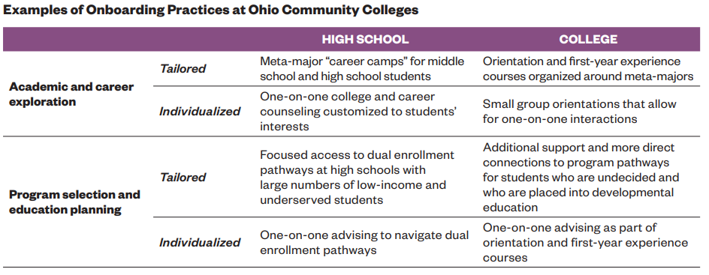
Examples of personalized onboarding practices for high school students
ASK, CONNECT
& PLAN

Slide 20
Examples of personalized onboarding practices for college students
ASK, CONNECT
& PLAN

Slide 21





Example: Why adult students benefit from tailored support during onboarding
Varying amounts of time out of education
Varying prior college experience
Different life experiences
Different career experiences
No clear institutionalized supports for college planning

Slide 22






How onboarding can be tailored to adult students at different stages of the process
Recruitment
Connecting with peers
Enrollment
Educational planning
Program selection
Confidence building

Slide 23
Personalizing the program onboarding experience
Program onboarding design principle | How can we personalize the experience to particular groups of students who are currently not well served—e.g., undecided students, older students, non-credit students, dual enrollment students, etc.? (Identify the student groups in each case)
ASK every student about their interests, strengths, aspirations
CONNECT them with faculty, students, alumni, others with similar interests
INSPIRE learning in term 1 through “light the fire” college-level courses on issues of interest
Help every student development individualized education PLAN aligned to jobs/transfer in field of interest by end of term 1

Slide 24
Thanks!
Hana Lahr, lahr@tc.columbia.edu

