Slide 1
Talent Strong Florida:
How Our State Can Support Students on Their
Postsecondary Journeys
Florida Pathways Institute III
Kimberly Lent
Assistant Director for Research and Policy,
Florida College Access Network

Slide 2
Florida College Access Network
Our mission:
We lead the collaborative movement to ensure every Floridian achieves an education beyond high school and a rewarding career.
Our vision:
A Florida working together, where education is the pathway to economic mobility for all.

Slide 3
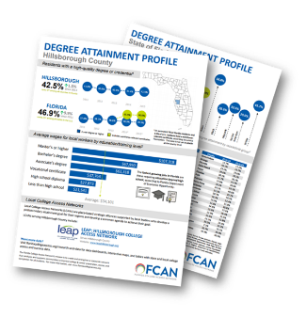
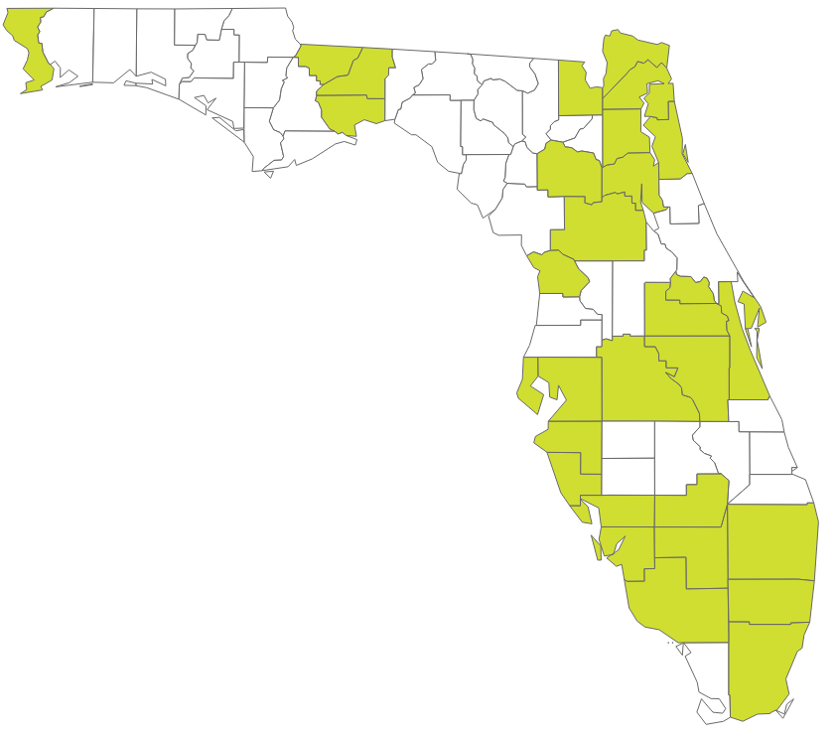
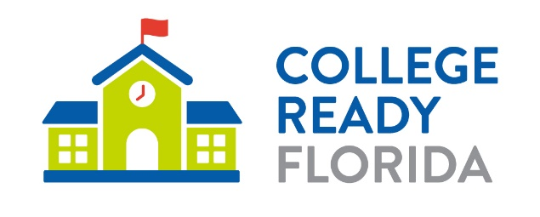
FCAN’s Work
Research and Data FCAN publishes research and data on evidence-based practices and policy opportunities to strengthen Florida's talent pool.
Local college access networks (LCANs) LCANs support 82% of the state’s population. These organizations are made up of community leaders who come together to create solutions and partnerships to support local talent development.
Statewide Initiatives FCAN coordinates 4 College Ready Florida initiatives that provides schools and community organizations resources to help students continue their education after high school.
Notes:
We do our work in 3 primary ways – shining a light on promising practices at the local and state level:
Research and data – We publish research and data on evidence-based practices and policy opportunities to strengthen Florida’s talent pool.
Local college access networks – cross-sector coalitions of leaders that collaborate to remove barriers and provide more support for student success
Statewide initiatives – we coordinate 4 College Ready Florida initiatives that provide schools and community organizations free resources to help students continue their education after high school.

Slide 4







Seven Conditions That Create a Resilient Workforce and Spark Economic Mobility
Opportunity for Everyone
Clear Information and Guidance
Affordability
Multiple
Pathways
Lifelong
Learning
Data-informed Decision-making
Community Collaboration
Notes:
7 conditions to build a resilient economy provides a roadmap for communities.
Equitable access and supports—all Floridians need access to postsecondary education and the supports to complete it. It is about opportunity for everyone.
Counseling & information—Students of all ages and families need exposure to clear guidance early and often so that informed decisions can be made.
Affordability—Regardless of household income or life circumstances, postsecondary education needs to be within everyone’s financial reach.
Multiple Pathways—Floridians benefit from multiple learning opportunities for academic achievement and career advancement.
Lifelong Learning—No degree or credential is “one and done;” in order to be a talent strong economy, Floridians must be prepared for career changes through continuous learning.
Data-Driven Decision Making—There must be transparent access to data on education and economic outcomes in order to achieve goals.
Community Partnerships—When partners collaborate toward a shared vision, they remove barriers, build a robust workforce and improve the quality of life for their regions.
We used several of these conditions as a guiding point for our Talent Strong Florida initiative.

Slide 5
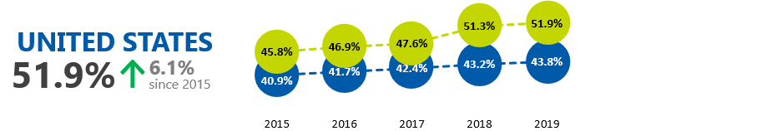
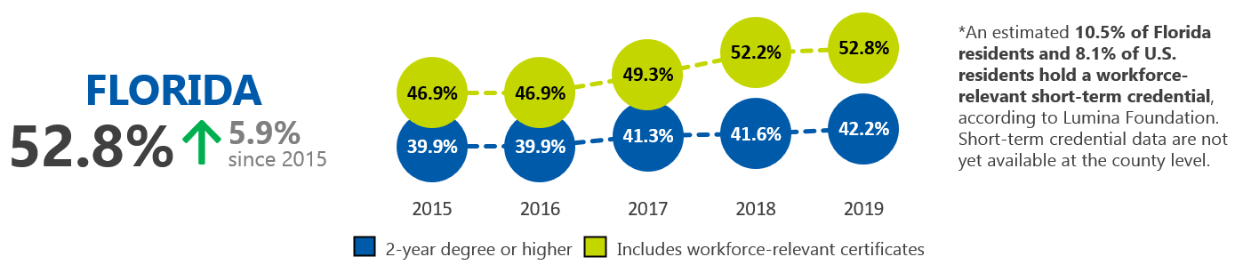
Florida Continues to Make Progress Toward the SAIL to 60 Goal

Slide 6
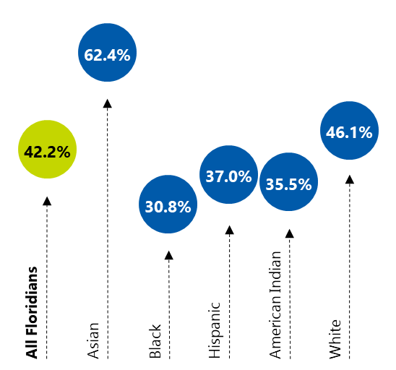
While 42.2% of all Floridians have a 2-year degree or higher, differences in attainment exist by race and ethnicity…
Source: U.S. Census Bureau, American Community Survey
Notes:
Source

Slide 7

Most Floridians of Working Age Will Be
Non-White by 2030
Working-Age Adults: 2019
Working-Age Adults: 2030
Source: University of Florida Bureau of Economic and Business Research
Notes:
Too often, opportunity in education and careers is inequitable, leaving too many people behind.
Florida’s working-age population will be 53% non-white by 2030, yet today, Black and Hispanic Floridians trail white Floridians in degree attainment by double digits (UF Bureau of Economic and Business Research)

Slide 8

Do students have the resources they need?
Only one in five Florida voters believe high school students have enough resources to make informed decisions.
Two in five see lack of access to career and education planning guidance as a barrier for students being able to make informed decisions about post-high school options.
Source: Breakthrough
Research surveys, March 2020 and August 2020.
Notes:
Just 20% of Florida voters believe that high schoolers are provided adequate resources to make informed decisions about options for education after high school
There are over 400 students for each school counselor at Florida’s public high schools (Oppaga)

Slide 9

Who should get an education beyond high school?
Nine out of ten Florida voters believe a college degree or credential is important for success in today’s workforce.
Three in five believe any students who wants to attend should have access to a college degree or credential beyond high school
Nine out of ten believe their children will go to college.
Source: Breakthrough Research surveys, August 2020.
Notes:
Just 20% of Florida voters believe that high schoolers are provided adequate resources to make informed decisions about options for education after high school
There are over 400 students for each school counselor at Florida’s public high schools (Oppaga)

Slide 10
FCAN believes guided pathways are key to creating a Talent Strong Florida and implementation should not fall on colleges alone.

Slide 11
How can state and community partners support your efforts?

Slide 12
How state and community partners fit in
1.
Building public will of the value of education beyond high school
2.
Providing information about possible pathways.
3.
Providing guidance and coaching to help student choose and enter their pathway.
Notes:
Last fall, FCAN launched Talent Strong Florida, a campaign that compliments Florida’s SAIL to 60 goal to strengthen Florida’s workforce and ensure the state is ready for the economy of the future. The state goal is to increase the percentage of Floridians ages 25 to 64 with a high-value postsecondary certificate, degree, or training experience to 60% by the year 2030.
While there are many paths to career success and being career ready, all involve education and training after high school, which boosts lifelong earnings – ultimately, putting more money into Floridians' pockets and Florida’s economy.
So what does it mean for Florida to be talent strong?
It means preparing our future workforce with the skills and education necessary to remain competitive in the global economy.
Ensuring prosperity for Florida families and our state in good times and bad.
And building an economy more resilient to recover from inevitable disruptions.
Today, we want to discuss what is being career ready and the skills that you as employers need in your team as you build a talent strong workforce but first, I would like to share a few key points about the Talent Strong Florida initiative.

Slide 13

A Talent Strong Florida means..
Preparing our future workforce with the skills and education necessary to remain competitive in the global economy
Prosperity for Florida families and our state in good times and bad
Building an economy more resilient to recover from inevitable disruptions
Notes:
Last fall, FCAN launched Talent Strong Florida, a campaign that compliments Florida’s SAIL to 60 goal to strengthen Florida’s workforce and ensure the state is ready for the economy of the future. The state goal is to increase the percentage of Floridians ages 25 to 64 with a high-value postsecondary certificate, degree, or training experience to 60% by the year 2030.
While there are many paths to career success and being career ready, all involve education and training after high school, which boosts lifelong earnings – ultimately, putting more money into Floridians' pockets and Florida’s economy.
So what does it mean for Florida to be talent strong?
It means preparing our future workforce with the skills and education necessary to remain competitive in the global economy.
Ensuring prosperity for Florida families and our state in good times and bad.
And building an economy more resilient to recover from inevitable disruptions.
Today, we want to discuss what is being career ready and the skills that you as employers need in your team as you build a talent strong workforce but first, I would like to share a few key points about the Talent Strong Florida initiative.

Slide 14

Far-reaching economic losses from COVID-19
58%
of Floridians reported
job loss, reduced hours,
or pay cuts
from COVID-19
Source: Breakthrough
Research survey, May 2020.
Notes:
A full 58% of Floridians surveyed in May 2020 said they have suffered job loss, reduced hours or pay cuts.

Slide 15
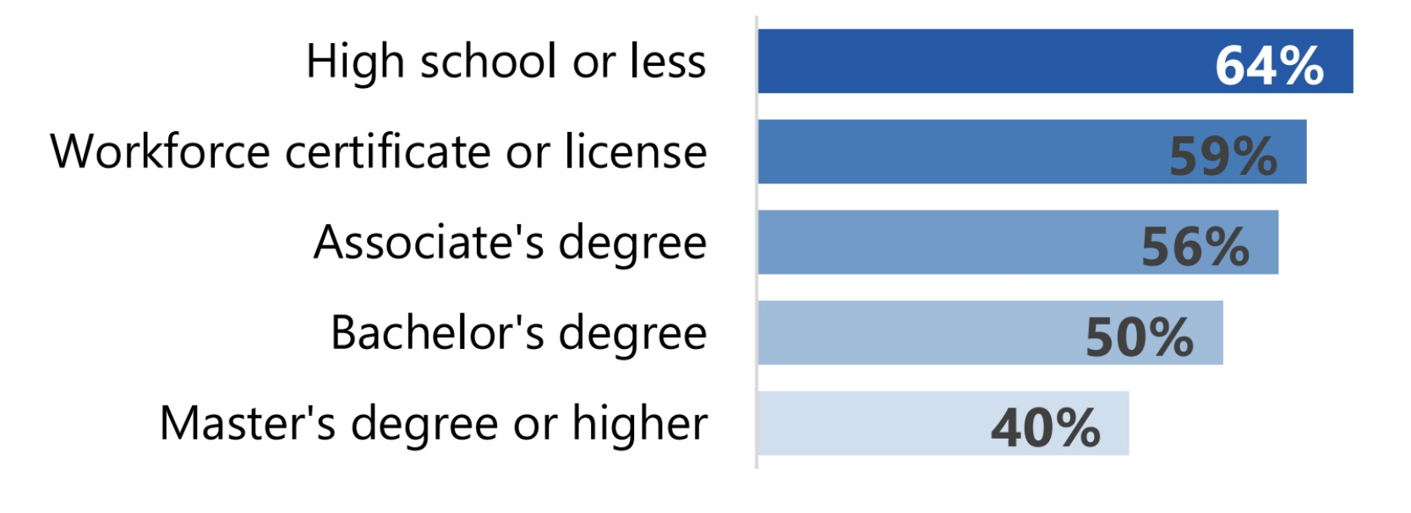
Due to COVID-19, lowest education levels had greatest job-related losses
Source: Breakthrough
Research surveys, May 2020.
Notes:
Particularly hard hit are Floridians with the lowest education: Floridians with a high school degree or less report the highest combined rates of job loss, pay cuts or reduced work hours due to COVID-19.
States with a well-educated workforce enjoy greater prosperity.

Slide 16
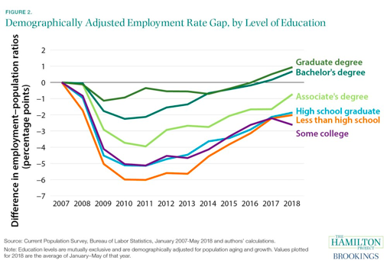
Higher education levels recover faster
People with higher
education levels
recovered fastest
from Great Recession
Source: Brookings Institution
Notes:
Education beyond high school is required to prepare for these jobs of the future and provide resiliency to weather future economic downturns.
Floridians with credentials beyond high school are more resilient during tough economic times. American adults with a bachelor’s degree or higher, as a group, enjoyed the strongest recovery from joblessness after the Great Recession, whereas those with lower levels of education still haven’t recovered (Brookings).

Slide 17

Is College for Everyone?
Two out of three new jobs will require education beyond high school by 2025
Nine out of ten Florida voters support making education beyond high school more accessible.
Almost 90% of Floridians believe that a college degree or credential beyond high school is important for the average Floridian to be successful in the future workforce.
Sources: Breakthrough Research surveys, March 2020 and August 2020, Florida Chamber of Commerce
Notes:
Although some people still believe that “college isn’t for everyone,” the reality is that education beyond high school -- in one form or another -- is essential for economic stability.
Nearly 80% of Floridians believe that everyone needs an education beyond high school.
According to the Florida Department of Economic Opportunity, 67% of new jobs in Florida will require a degree or credential beyond high school by 2025. In fact, all of the top ten fastest growing jobs in Florida will require a certificate or degree.
91% of Florida voters support making education beyond high school more accessible.

Slide 18
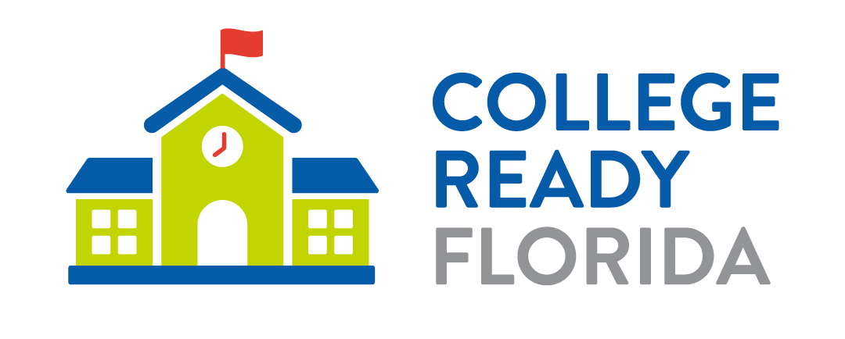

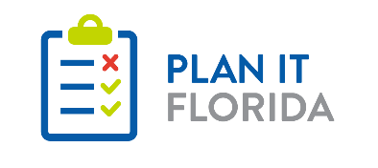


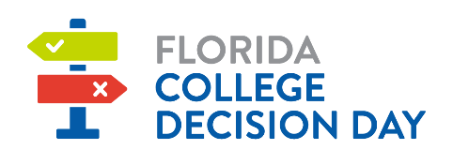
Providing information on pathways

Slide 19
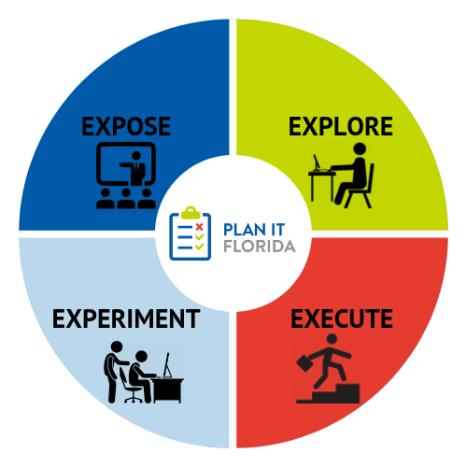
Goal: Every student will graduate high school with a plan for life after graduation.

Slide 20
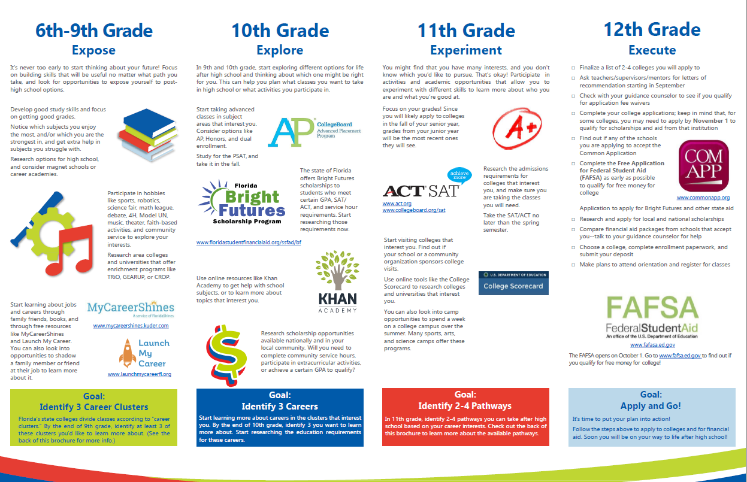

Slide 21

Local College Access Networks are multi-sector partnerships that create solutions to support local talent development.
17
regional networks throughout Florida
organizations and institutions within these networks including school districts, colleges and universities, career and technical colleges, nonprofits, philanthropy, business and government leaders
600
82%
of Florida’s population is supported by one of these coalitions

Slide 22

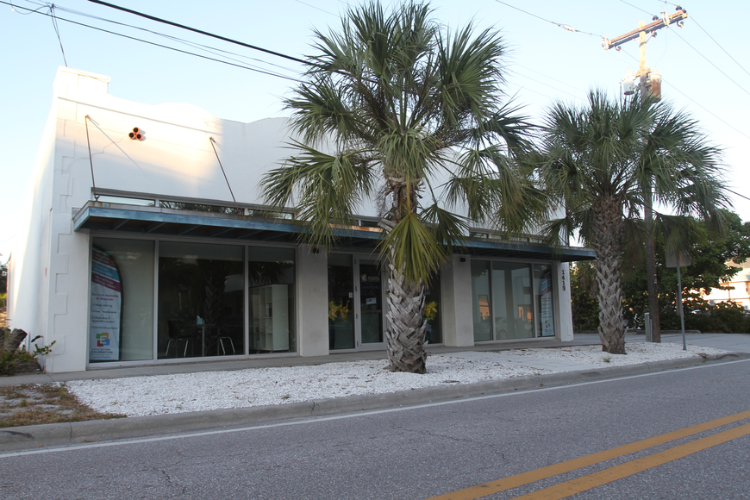
PLANit Sarasota’s LaunchPad4U
Opened in June 2020
Community resource center and learning lab to ensure students graduate with a plan for their futures
Access to volunteer mentors and trained professionals
Workshops on success activities

Slide 23
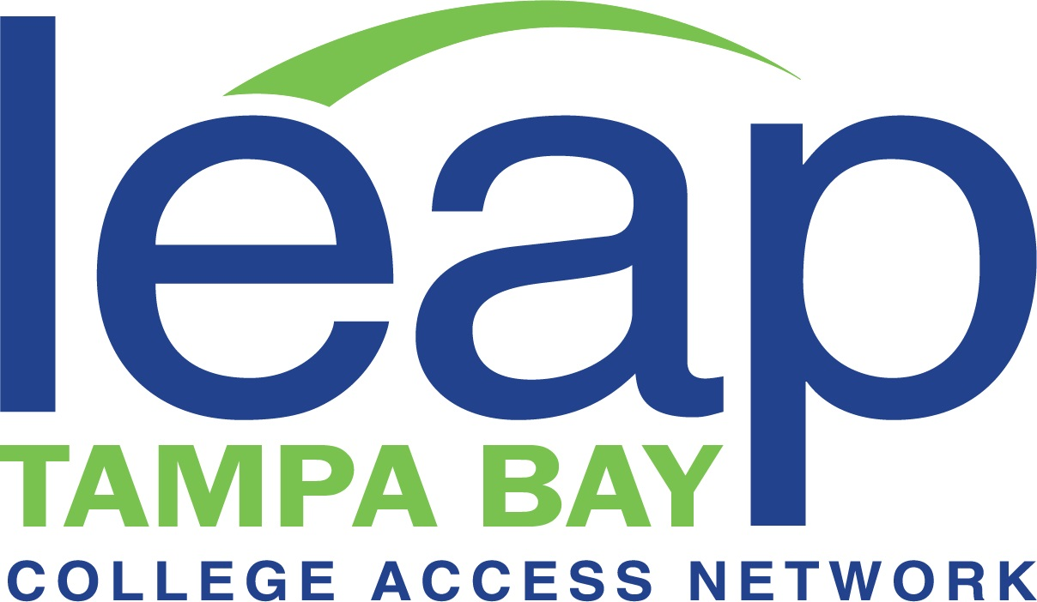
LEAP’s Complete Tampa Bay Initiative
Partnership between LEAP Tampa Bay, SPC, HCC, Pinellas Technical Colleges, Hillsborough Technical Colleges, and USF
Goal is to reengage adult learners who have stopped out
Interested students are paired with a completion coach to determine the right path for them and the resources needed
Partnership with Knack and Pinellas County Urban League provides students with free peer-to-peer tutoring

Slide 24
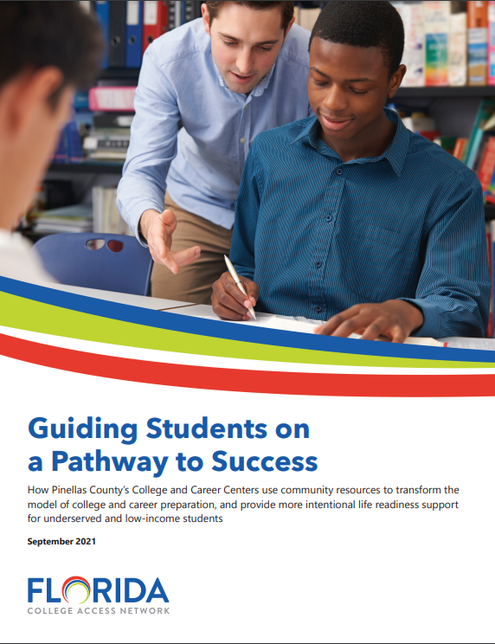
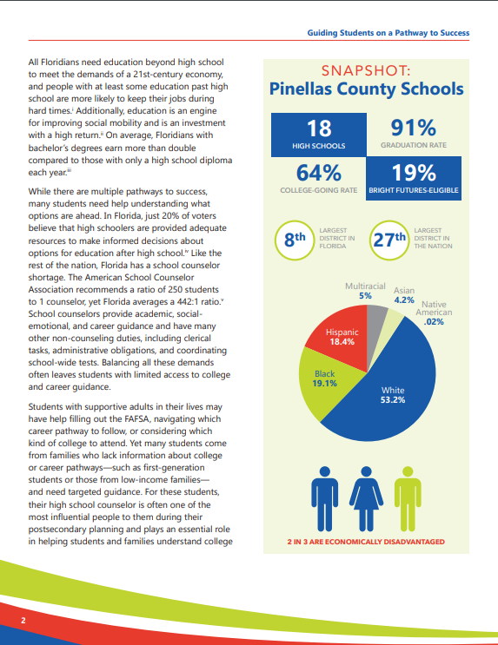
Pinellas County’s College and Career Centers

Slide 25

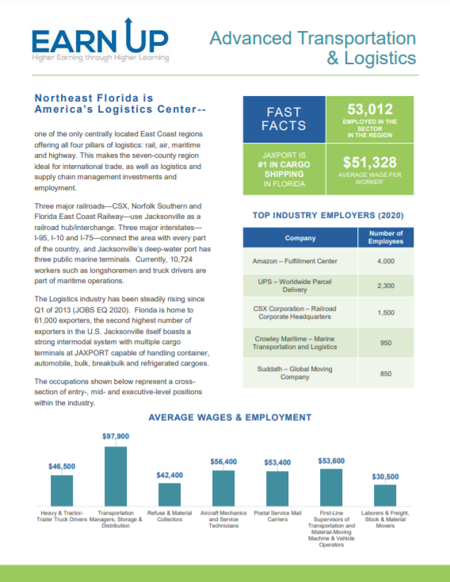
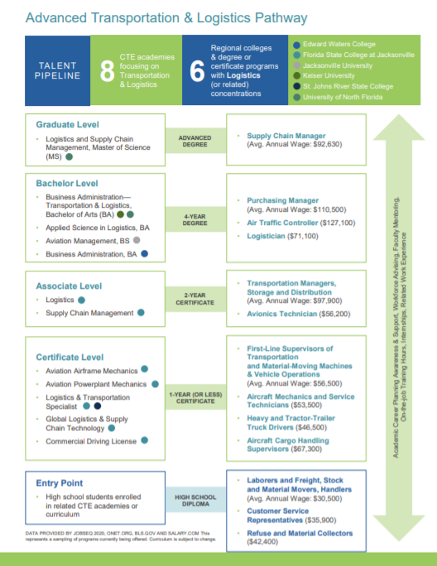
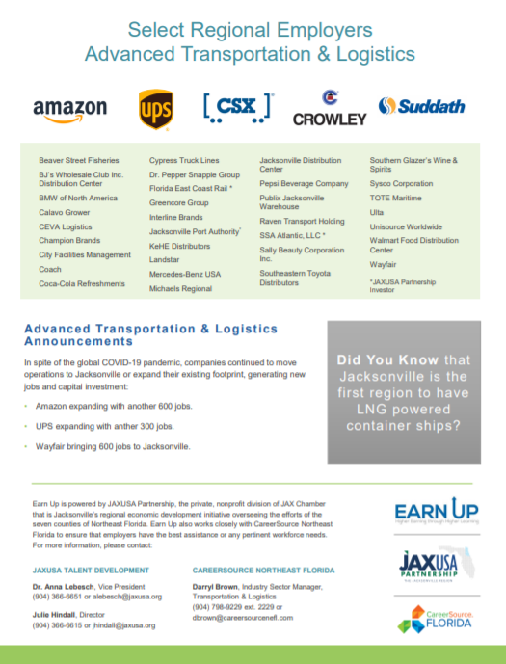
Earn Up’s Career Pathways

Slide 26
Thank you!
Kimberly Lent
Assistant Director for Research and Policy
Florida College Access Network
klent@floridacollegeaccess.org

