Slide 1


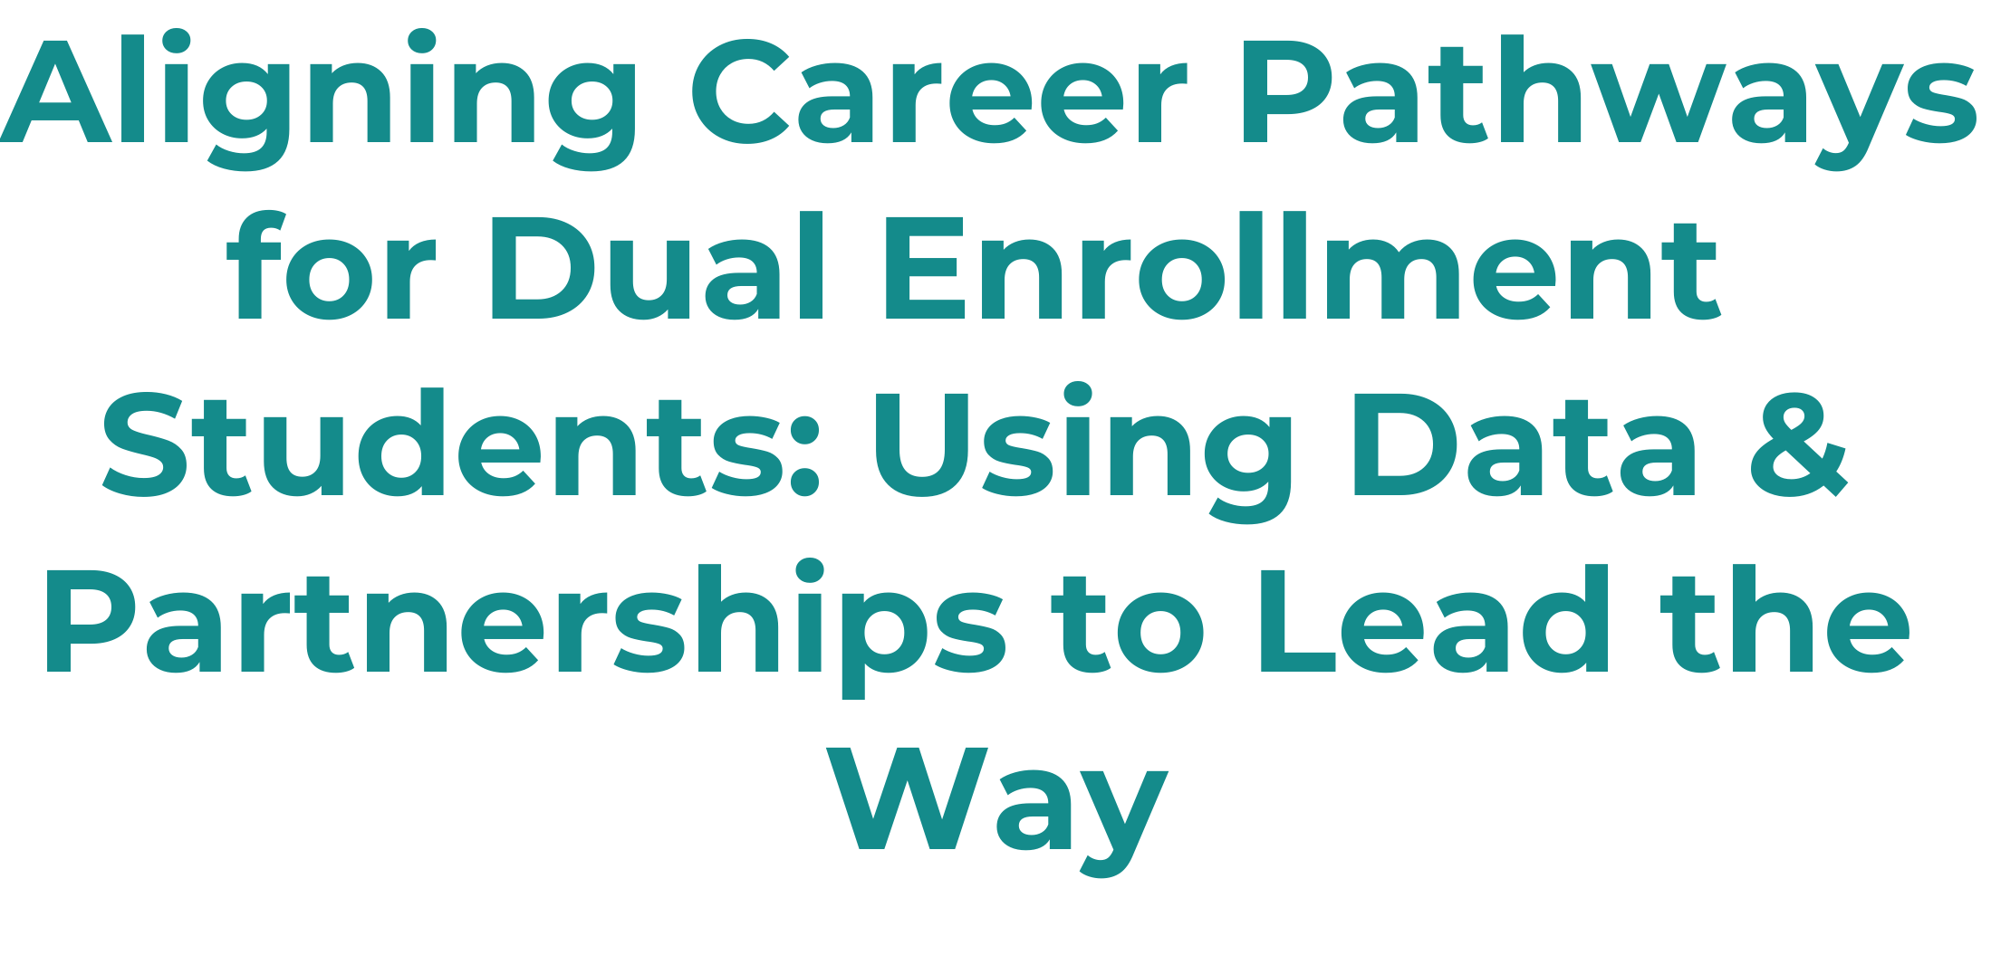
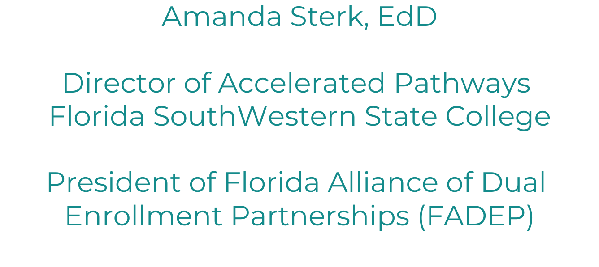
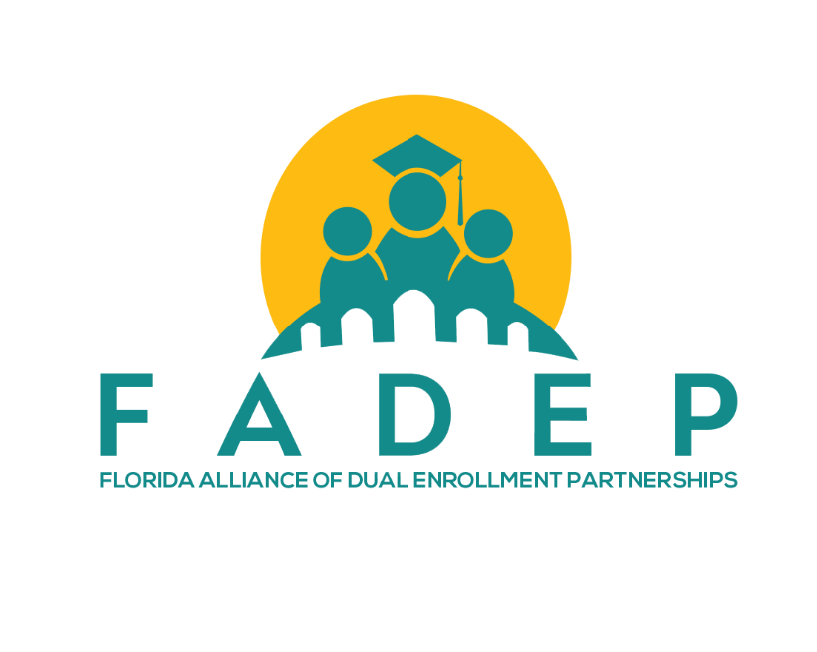


Slide 2


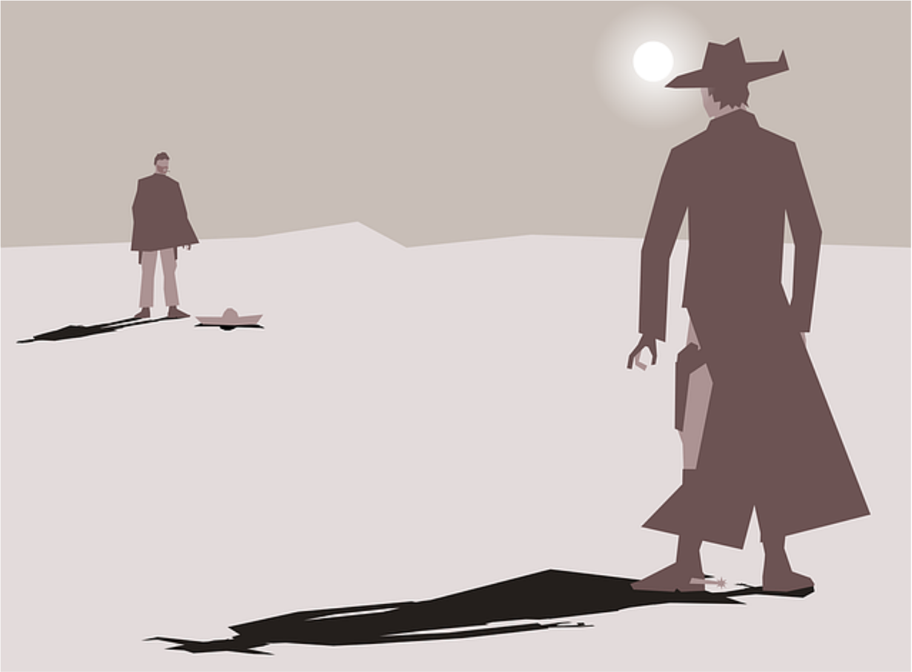


Slide 3




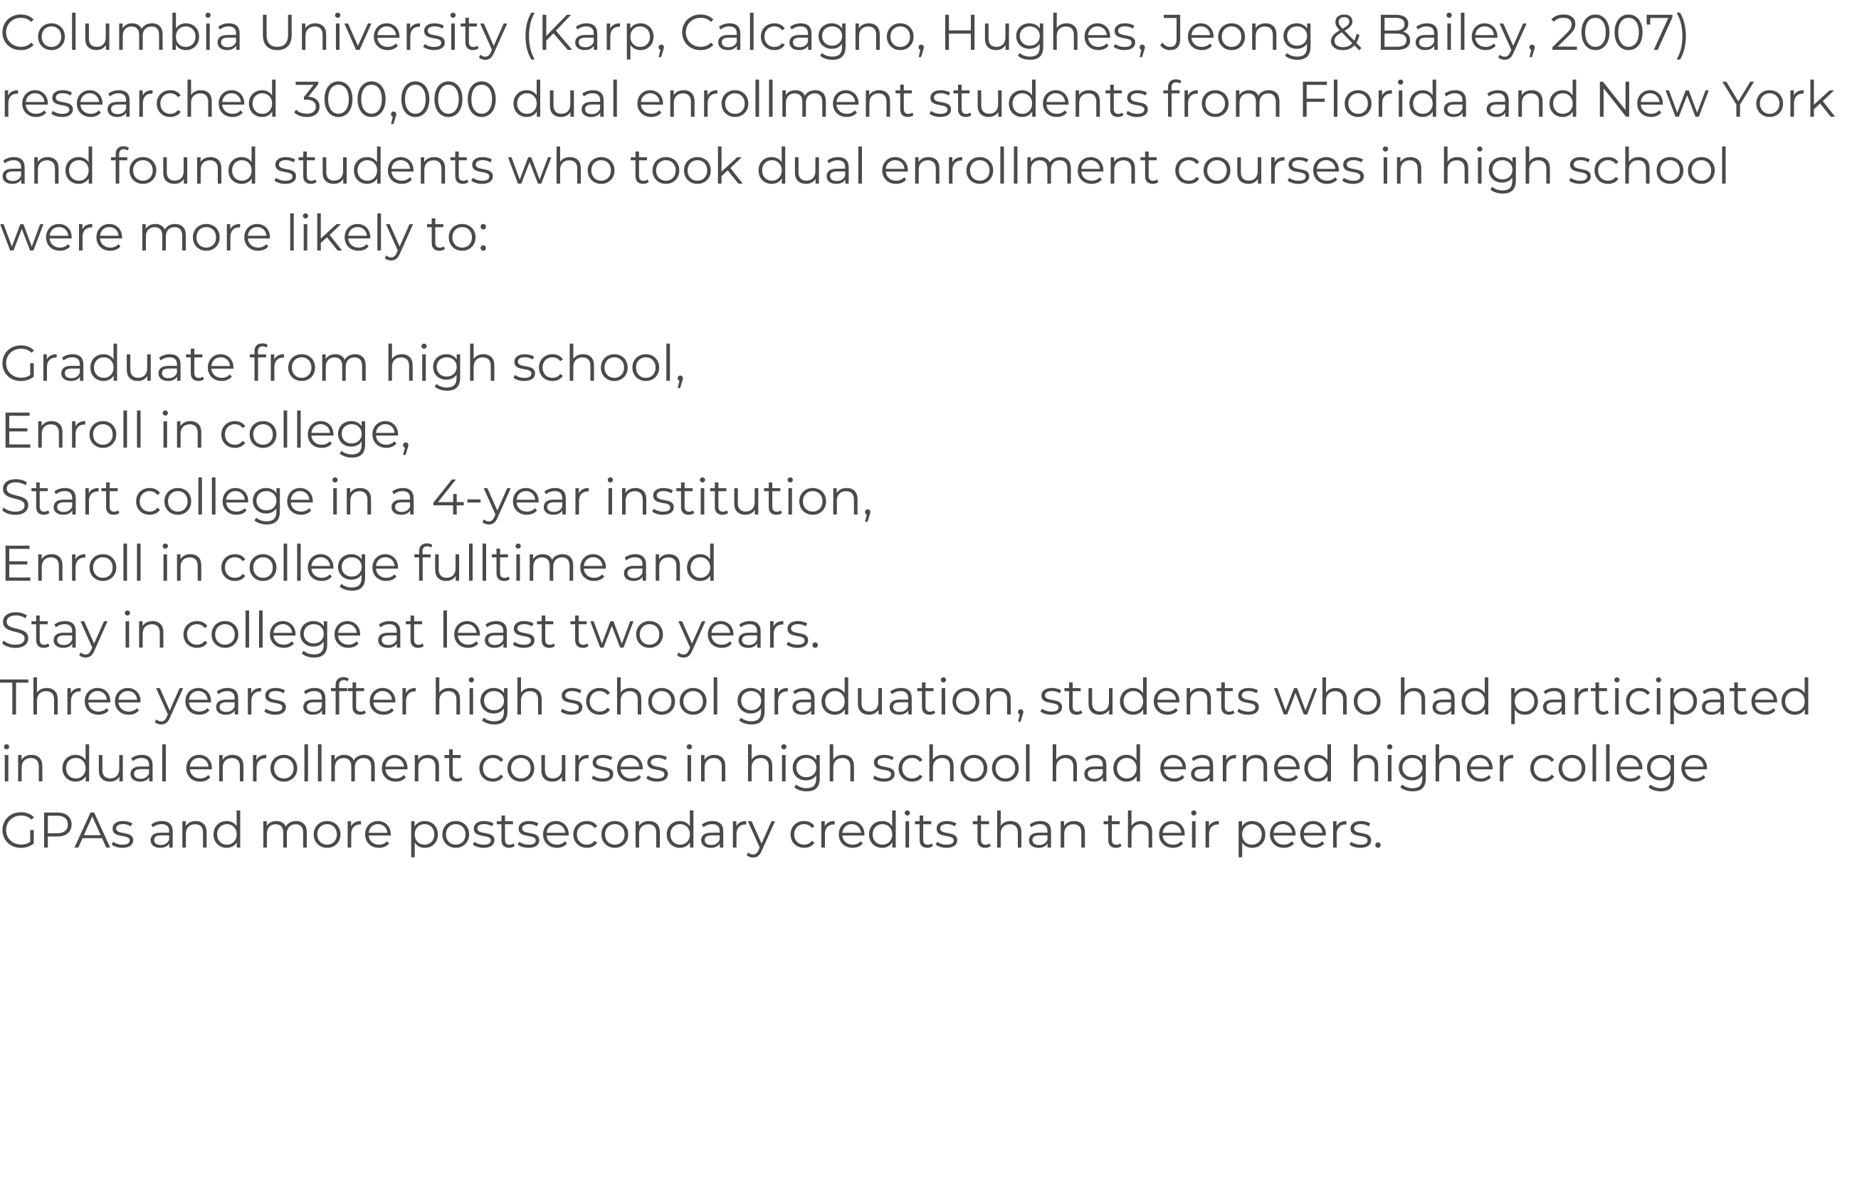









Slide 4

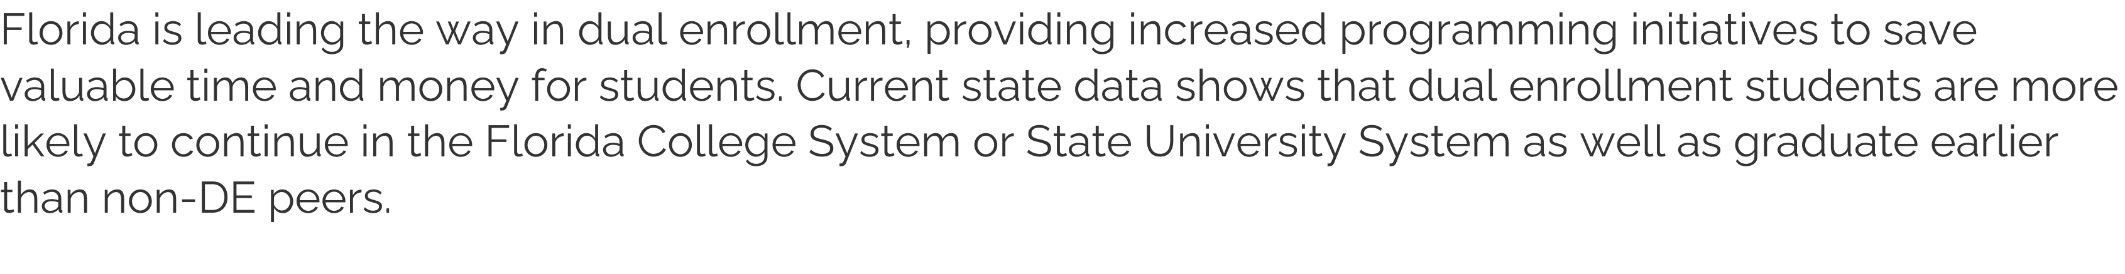
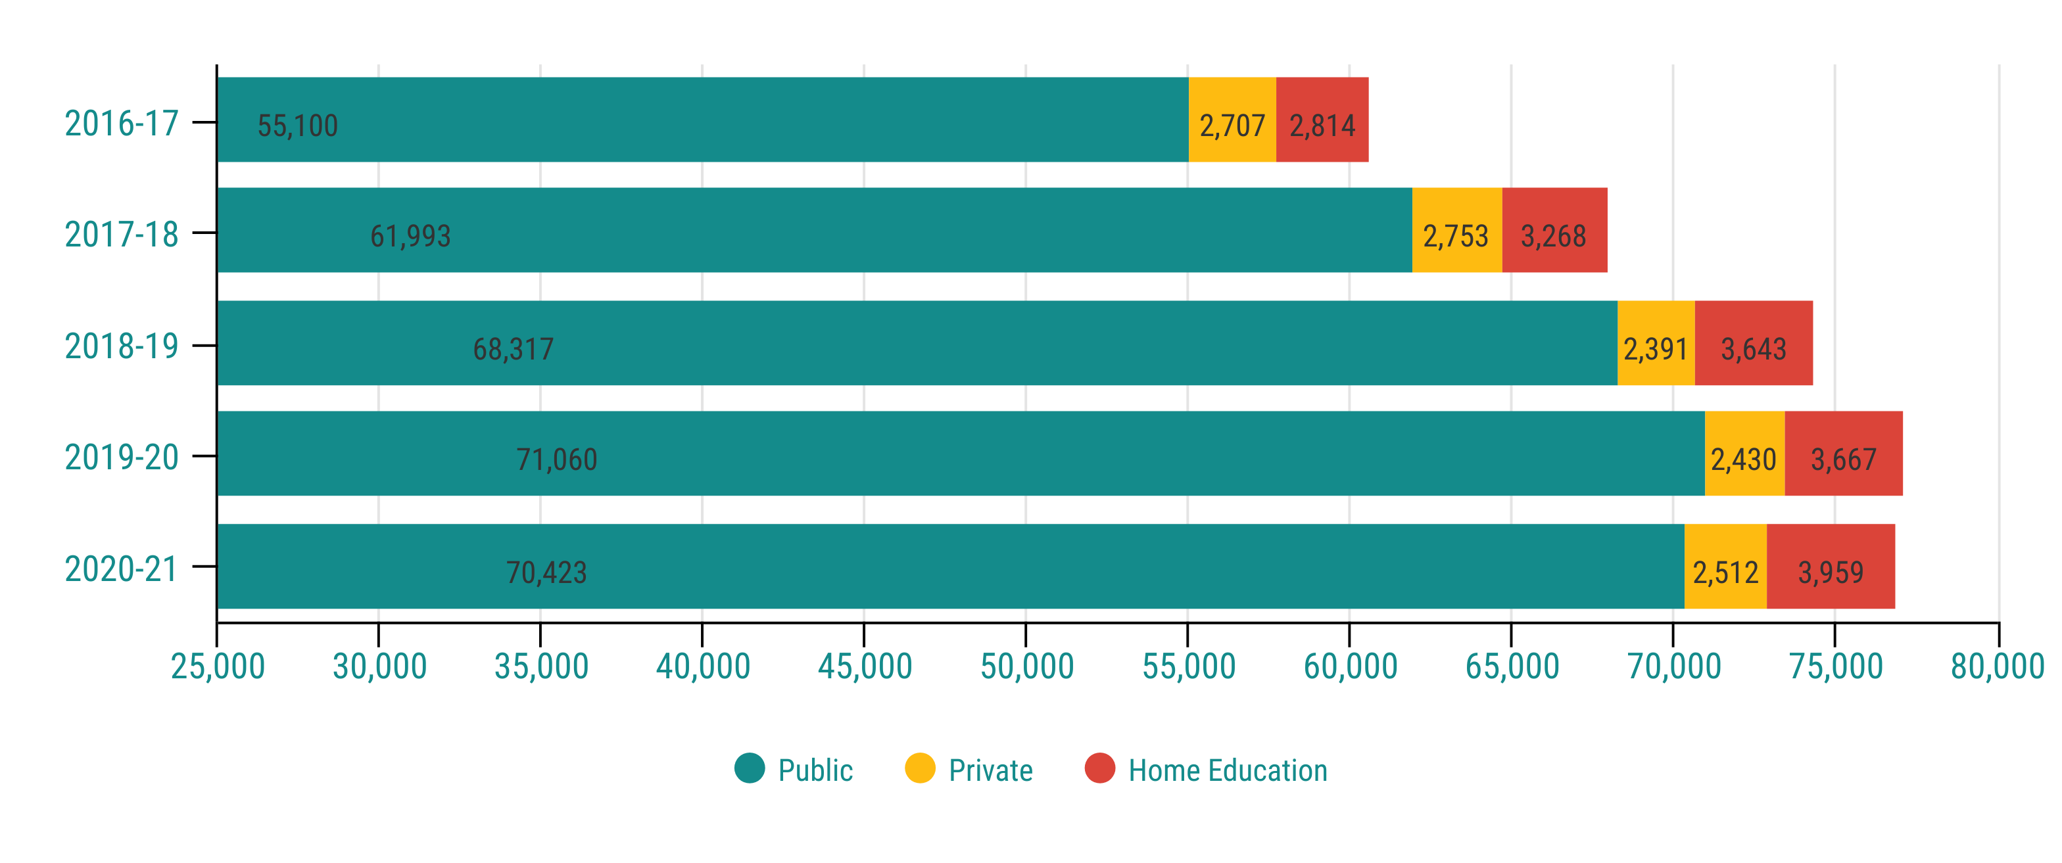

Slide 5
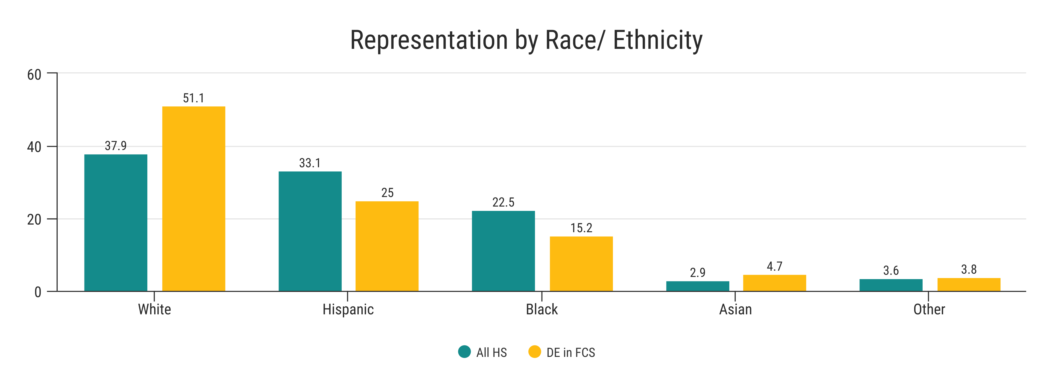

Slide 6
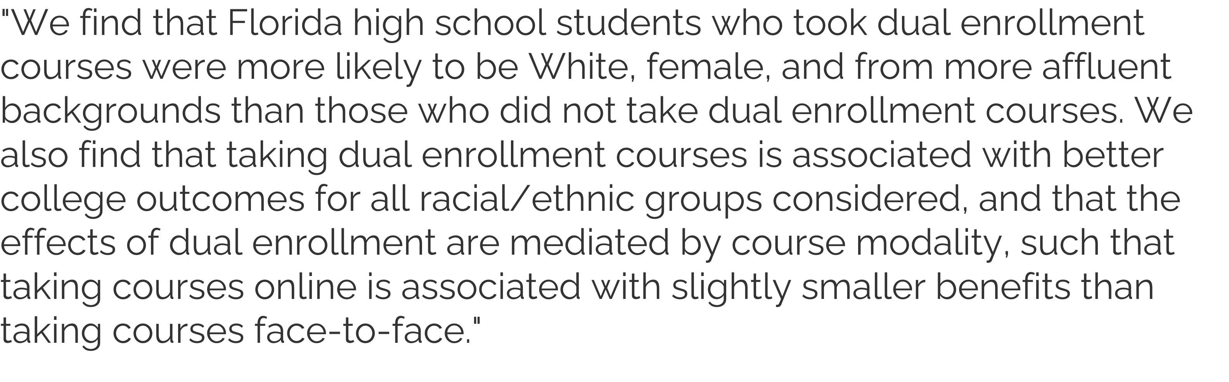

Slide 7
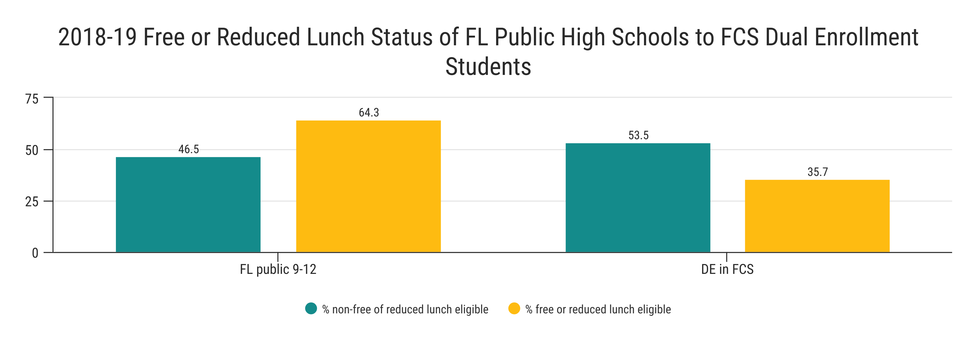
Florida DE students (2007-2012 data) were 18% less likely to receive FRPL than non-DE students (CCRC, 2020).

Slide 8
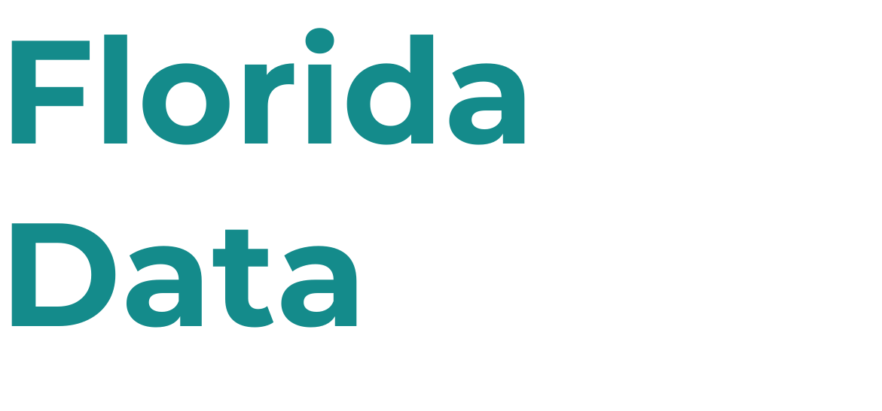
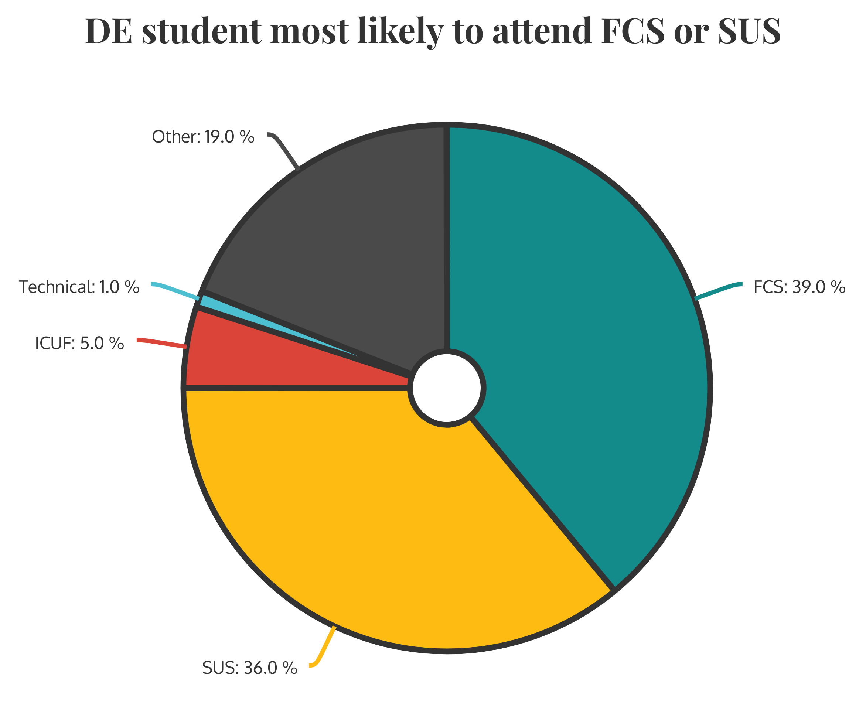

Slide 9
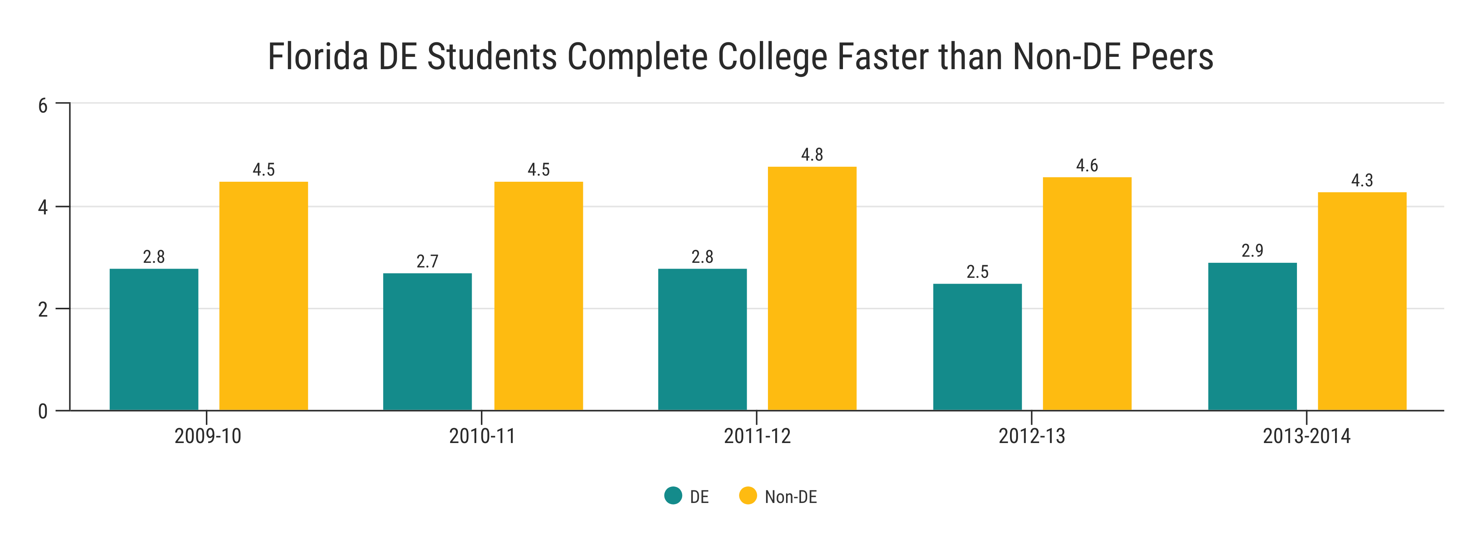

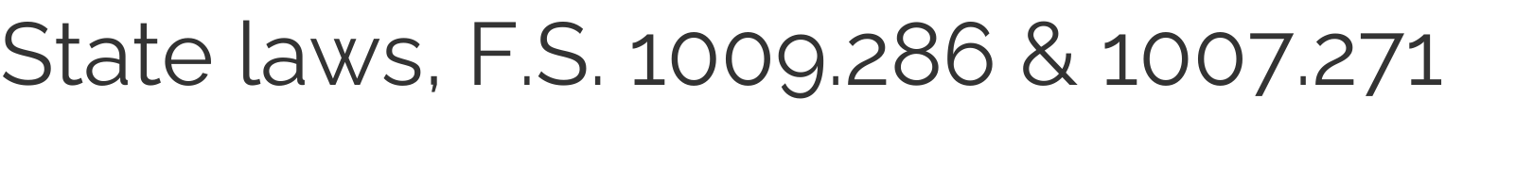

Slide 10

55,346
63,212
334,193
Fl. students received a 3,4,5 on AP
Fl. students participate in AICE courses
Fl. students participates in CTE
https://www.fldoe.org/newsroom/latest-news/florida-soars-on-advanced-placement-performance.stml
https://www.flsenate.gov/Session/Bill/2021/918/Analyses/2021s00918.aed.PDF
https://cte.ed.gov/profiles/florida

Slide 11







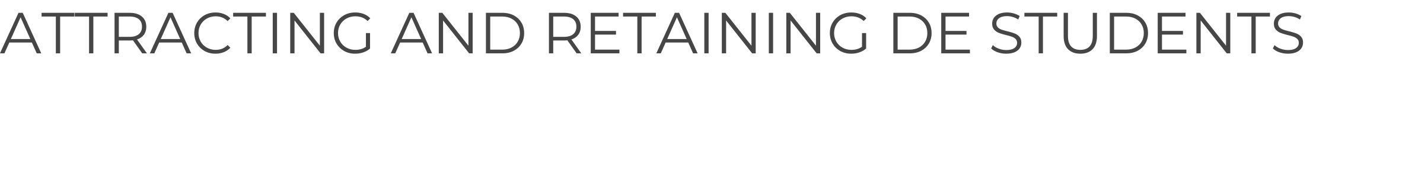

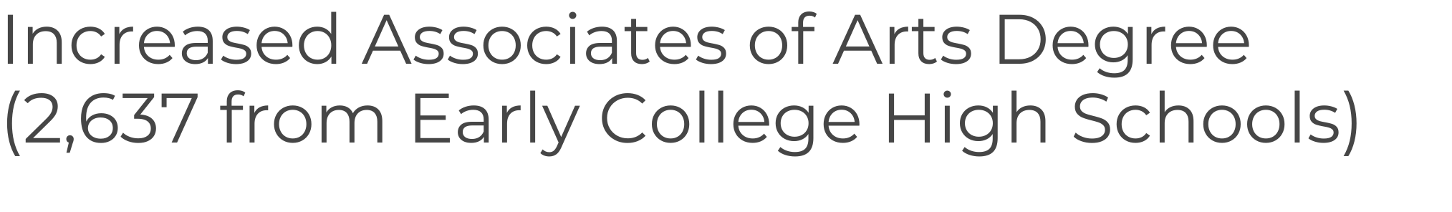

Slide 12







High Schools
Limited storage
Easy integration
Career Pathways
SUS
FCS

Slide 13


























Slide 14


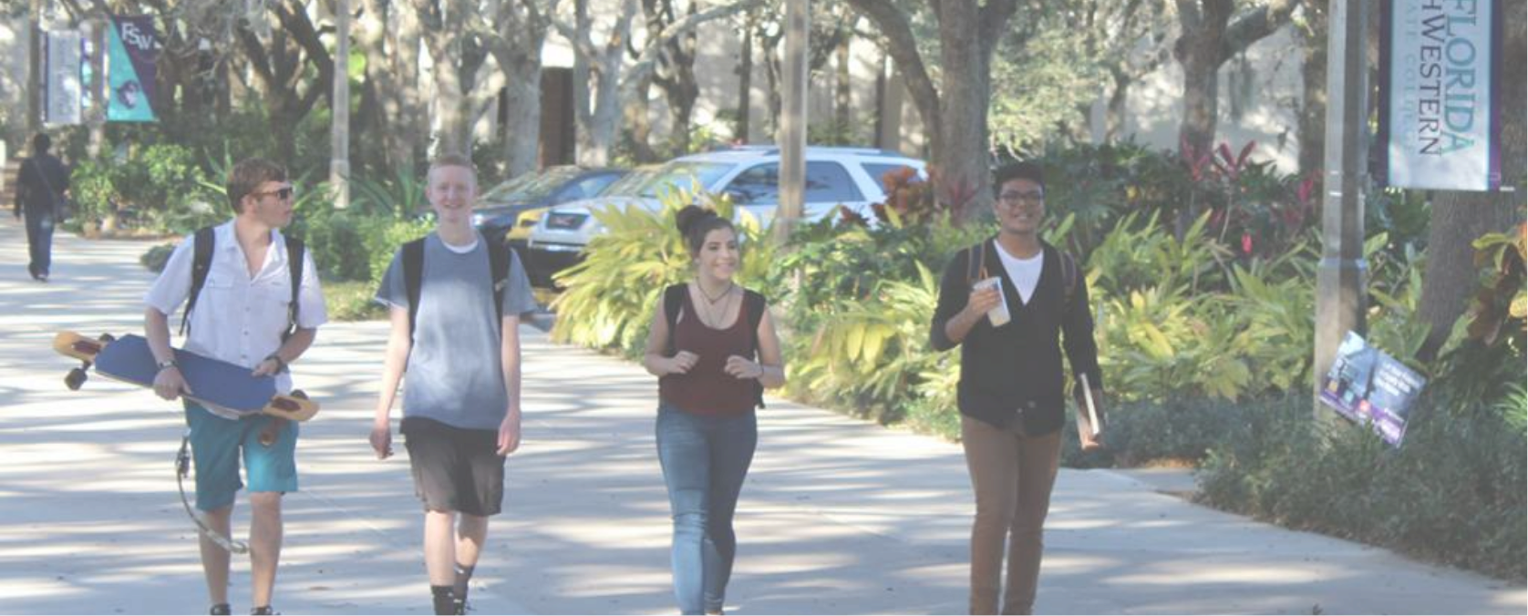






Collaboration
Who should be at the table?
Develop team early
Short term vs. long term
Annual vs. bi-annual
1 Institutional Agreement
Small to medium businesses need a range of artists (graphic designers, video editors, musicians, writers)
to create unique content.
Partnerships
How to support one another (K-12/ FCS)
Other areas of growth
Frequent review
Artists of any age and talent level can connect with employers who need their services.

