Slide 1
MDC’s Shark Path: A Holistic Guided Pathway Experience
Mr. Adam Porro
Miami Dade College
October 20, 2021

Slide 2
Session Objectives
Describe the MDC Shark Path guided pathway model from onboarding through completion.
Identify different ways that technology can be used to engage and support student onboarding, including individualized advising and orientation.
Explain best practices associated with student success focusing on comprehensive holistic support from the moment of inquiry through completion.
Describe the latest collaboration between Student and Academic Affairs in student success outcomes.
Miami Dade College

Slide 3
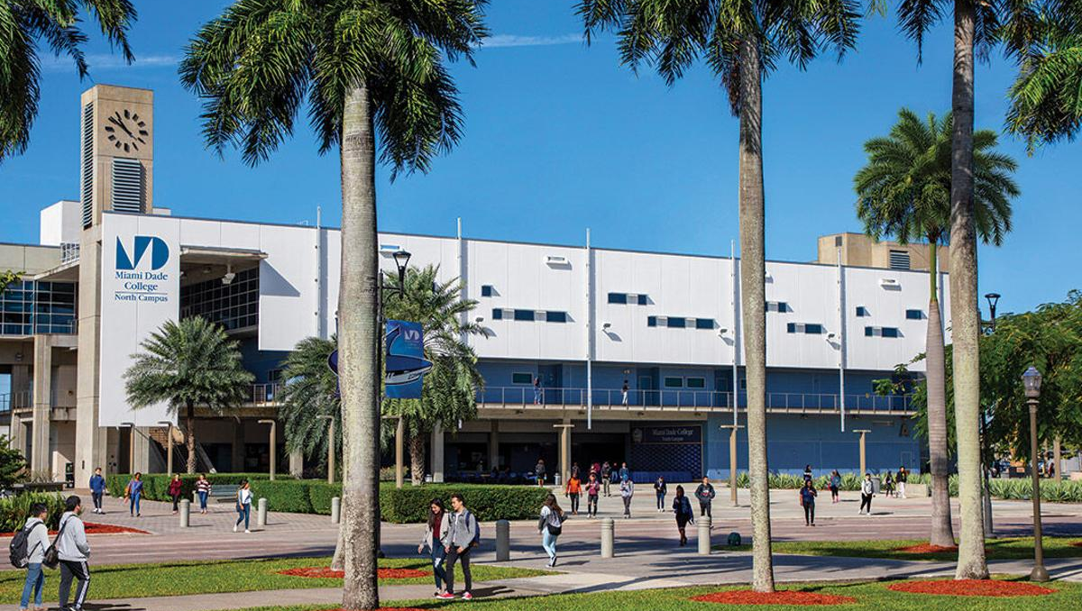




Miami Dade College
Background
Large public state college in Miami, FL
Over 52,000 undergraduate students currently enrolled in the Fall term
44% graduation rate (Full-Time degree/certificate seeking students), and 65% Fall-to-Fall retention rate
67% are low income, 47% live below poverty level
Challenge
After assessing its student performance data in 2010, Miami Dade College realized that too many barriers prevented students from staying in college or completing academic programs.
Notes:
The process of designing the change engaged many campus voices. Starting in 2011, teams analyzed student data, developed hypotheses about obstacles to completion, reviewed literature, and conducted surveys and focus groups. They adopted a guided pathway model to redesign academic and student services that support a student’s journey. Named for the college’s mascot, “Shark Path” is an intentional weave of strategies, programs, activities, and interventions that aligns academic and support services and guides students from before they enter college to completion of a credential and transition to either a baccalaureate program or the workplace. The Shark Path includes academic maps that help students reach graduation as quickly as possible while incurring minimal financial burden. A new student onboarding process and a first-year experience course help smooth the transition from high school to college, while an early alert system identifies students who struggle academically and matches them with needed advising. Students are assigned to advisors starting when they are still in high school and progressing to when they are in their first year of college and beyond

Slide 4






MDC at a Glance
8 CAMPUSES
plus satellite sites with flexible scheduling. AM, PM, weekend, and virtual options
97% of students
graduate without federal student loan debt
79% of AA graduates
continue their education at a Florida college or university.
Miami Dade College
OVER 167
countries represented
by the student body
#1 IN THE COUNTRY
in Associate Degrees awarded to Hispanic students. #3 in Associate Degrees awarded to African American students.
96% of AS graduates
are employed within a year of graduation.

Slide 5






Establishing Strong Early Connections
Academic Advising
Academic Programs
Financial Aid
Miami Dade College
Pre-College Advisor
Student
Admissions
Notes:
Make Academic Programs nice, Add Scholarship Opportunities

Slide 6
The Onboarding Process
MDC in the Cloud
Student Preparation
Orientation
Advisor Meeting
Prior to starting their 1st semester, students
Register for a Shark Start Orientation
Log into Navigate Student and opts into email and text messages from their support team
Complete the Sharks Intake Form
Complete the Shark Prep Orientation
Student attends Shark Start Orientation in-person or via Blackboard Collaborate/
Zoom for virtual sessions
At orientation, students:
Meet their support team
Obtain their 1st semester class schedule
Gain an understanding of the various technology platforms
Learn about the financial aid opportunities available
Following Virtual Shark Start Orientation, students sign-up for a 1-on-1 meeting with their assigned academic advisor.
At this meeting, students:
Complete their My Academic Plan (MAP) through degree completion
Are provided referrals to various on-campus support services
Advisors target completion of this appointment before 2nd term registration
Miami Dade College
Notes:
Fix orientation bucket

Slide 7
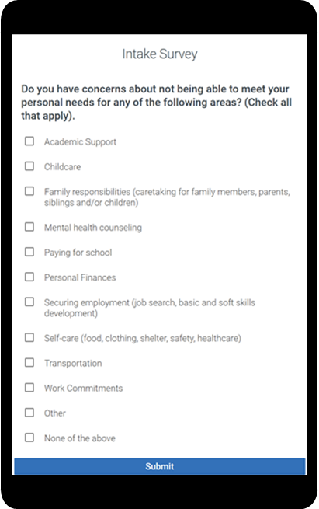
Holistic Student Support
Connects students to resources
Adds to-do’s to their path
Visible to advisors immediately
Questions include:
  Do you have concerns about not being able to meet your personal needs for any of the following areas?
  How do you plan to pay for College?
  Would you like information about any of the following services available.
  Would you like to learn more about any of the accelerated degree completion opportunities at MDC?
Holistic Intake
Miami Dade College

Slide 8
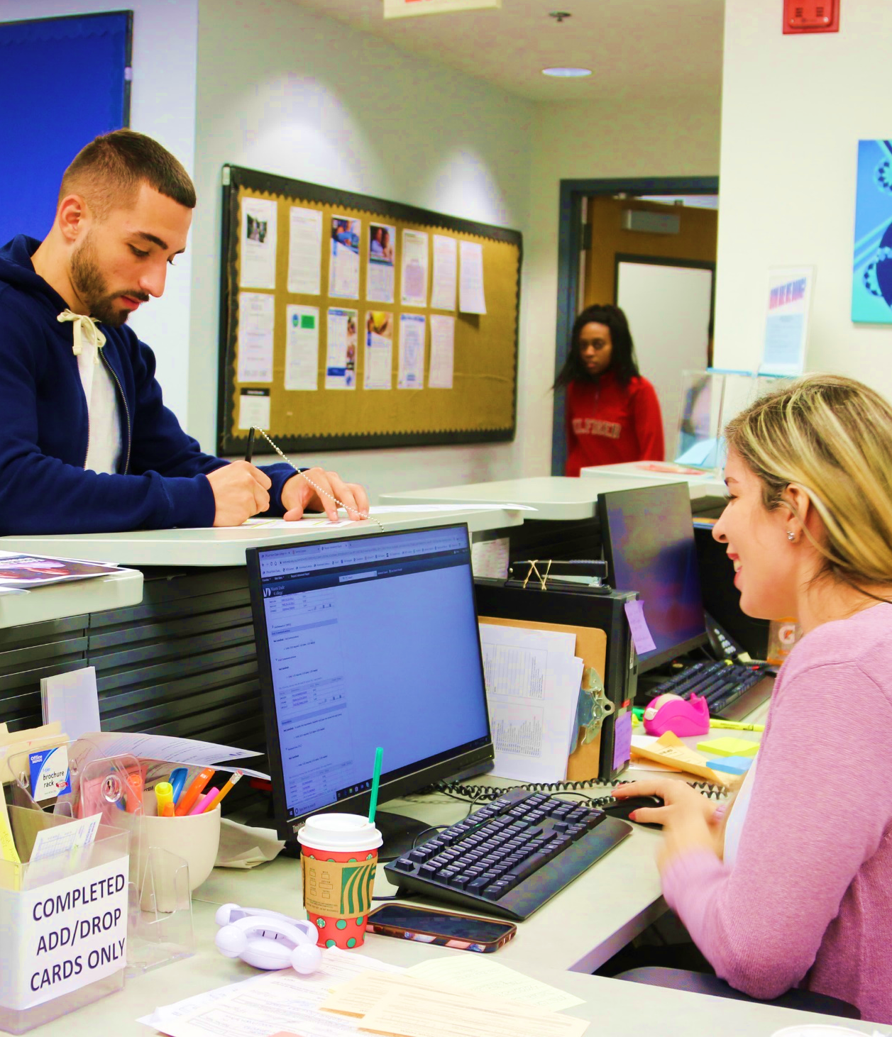
The Student’s Success Team
Academic and
Career Advisors
Assigned to students at orientation
Assist with degree mapping and transferability using the Navigate Student platform
Partner with MDC Works Studio to offer resume building and interviewing skills’ workshop
Assist students with job placement and internships
Miami Dade College

Slide 9

Student Support Services
Assigned to students at orientation
Assist with degree mapping and transferability using the Navigate Student platform
Partner with MDC Works Studio to offer resume building and interviewing skills’ workshop
Assist students with job placement and internships
ACCESS (Disability Services)
Learning Resources
Miami Dade College
Single Stop
MDC Works
Getting Involved

Slide 10







Staff Preparation for Onboarding Support
Staff training is paramount, all staff are required to attend annual onboarding training and ad-hoc trainings as needed.
Orientation
How to onboard new MDC students
Navigate 101
What you can access
How to send outreach
The student dashboard
Early Alerts
Importance of proactive alerts
How to submit progress reports and alerts in Navigate
Predictive Analytics
Appreciative advising principles
Applying MDC advising practices to predictive model
Communication Technology
How to use key platforms Navigate, Signal Vine, Blackboard, Teams, and Zoom
Student Communications
MDC communication protocols and standards
Best practices for emails and texts within Navigate
Academic Planning
How to build a plan template and use the shared workspace
Protocol for helping students build their plans
Miami Dade College

Slide 11
Early Alerts and Student Success
Student Alerts
GOAL: Provide support and enhance completion rates of students enrolled in key courses at the College by encouraging faculty to provide early alerts via progress reports or individual student alerts throughout the semester
~30,000 students enrolled in ALC identified courses
Proactive Nudging
GOAL: Help students become aware of resources available to them and encourage students to make good decisions from their very first semester at the College
~11,000 students enrolled in ENC1101
~600 faculty teaching ALC identified courses
Miami Dade College

Slide 12
Proactive Nudging
Text nudges throughout the semester to engage students with academic and non-academic content; open lines of communication; teach students HOW and WHEN to use support systems.
Early Check-In
Week 1
Week 2
Week 3
Week 4
Week 5:
Week 6
Week 7
Week 8
Week 9
Week 10
Week 11
Week 12
Week 13
Week 14
Week 15
Week 16
Introduction
Introduction to tutoring
Introduction to library services
APA and MLA styles
Check-in: office hours
Writing support resources
Citing and paraphrasing
Non-academic supports
Information literacy/research
Mid-semester check-in
Time management
Meet with your advisor: register
FAFSA & Scholarships
Thesis statement
Positive reinforcement
Submitting final assignments
Ready for next term check-in
Writing Wednesday Workshops
Miami Dade College

Slide 13
Early Alerts
Timely response to faculty alert
Keep faculty aware of support being provided
Follow-up to ensure utilization of resource(s)
Professor has concern
Blackboard assists in alert and/or intervention
Classroom-based intervention occurs
Professor indicates concern in Navigate
Professor submits alert or progress report
Student receives automated email
Email includes relevant resources
1
2
3
Miami Dade College
College Success Coach follows up
Success Coach ensures student receives needed support
College Success Team manages case
Team refers the case to appropriate support staff
Navigate case is automatically created
Faculty is assigned as “case owner”
6
5
4

Slide 14
Recruitment – FTIC Onboarding Group
Goal:
Increase overall FTIC-DE Fall 2021 enrollment by 10% from 8,827* to 9,710
Majority Campus | FTIC DE Fall 2019 Enrolled Cohort Term Totals [End of Term] | FTIC DE Fall 2020 Enrolled Cohort Term Totals [End of Term] | FTIC DE Fall 2021 Projected Enrollment (10% increase based on 2020 figures) | FTIC DE Fall 2021 Enrolled Cohort Term Totals [as of 9/27/21] | FTIC DE Fall 2021 Percentage of Enrollment Goal
Kendall | 3,765 | 2,905 | 3,196 | 2,958 | 93%
North | 1,706 | 1,414 | 1,555 | 1,551 | 100%
Wolfson | 1,554 | 1,185 | 1,304 | 1,172 | 90%
Hialeah | 1,065 | 906 | 997 | 1,041 | 104%
MDC Online | 198 | 693 | 762 | 512 | 67%
West | 716 | 633 | 696 | 660 | 95%
Homestead | 785 | 521 | 573 | 583 | 102%
Padron | 540 | 503 | 553 | 525 | 95%
Medical | 51 | 67 | 74 | 45 | 61%
Cohort Total | 10,380 | 8,827 | 9,710 | 9,047 | 93%
Miami Dade College
Goal
not yet met
* Fall 2020 enrolled total of 8,827 is end of term data

Slide 15
Retention
Goal: Increase the College’s Fall-to-Fall retention rate by 4 percentage points from 61% to 65%*.
Source: IR Combined Credit Student Not Enrolled Report.
To replicate, filter FTIC_STRM by 2207
Majority Campus | Enrolled Fall 2020 Term | Enrolled Fall 2021 (09/26/2021) | Percentage Enrolled (09/26/2021) | Goal- Students Enrolled at 65% Benchmark | Percent Towards 65% Benchmark Goal (09/26/2021)
HIA | 739 | 477 | 65% | 480 | 99%
HOME | 442 | 273 | 62% | 287 | 95%
KENDL | 2324 | 1591 | 68% | 1511 | 105%
MEDI | 144 | 57 | 40% | 94 | 61%
MEEK | 81 | 36 | 44% | 53 | 68%
NORTH | 1279 | 705 | 55% | 831 | 85%
PADRON | 529 | 346 | 65% | 344 | 101%
VIRTU | 1454 | 948 | 65% | 945 | 100%
WEST | 520 | 365 | 70% | 338 | 108%
WOLF | 1154 | 740 | 64% | 750 | 99%
Grand Total | 8666 | 5538 | 64% | 5633 | 98%
Miami Dade College
Strategy:
Use IR Combined Credit Student Report for outreach to all FTIC (IR definition)students who enrolled Fall 2020 and not enrolled Fall 2021
Promote completion of 2021-2022 FAFSA for continuing students (pivot in FTIC Snapshot file)
* Goal of 65% is excluding graduates
In progress - goal not yet met

Slide 16
Reclaim
Majority Campus Last Term Attended | Not Enrolled Fall 2021 | Enrolled Fall 2021 | Grand Total
HIA | 2394 | 90 | 2484
HOME | 1544 | 62 | 1606
IAC | 933 | 17 | 950
KENDL | 6984 | 324 | 7308
MEDI | 954 | 37 | 991
MEEK | 252 | 12 | 264
NORTH | 5592 | 207 | 5799
PADRO | 1365 | 65 | 1430
VIRTU | 4613 | 194 | 4807
WEST | 1586 | 75 | 1661
WOLF | 4411 | 191 | 4602
Grand Total | 30628 | 1274 | 31902
Goal: Reclaim students with a last term enrolled of Summer 2020 or prior through Fall 2018.
Source: Reclaim file vs 9/26/21 Majority Campus Roster
Strategies:
Use Reclaim Report for outreach to all students who last enrolled between Fall 2018 and Summer 2020 and not enrolled Fall 2021
Report provides breakdown by completion benchmarks and majority campus last term attended
Promote the Welcome Back or Last Mile Scholarship for students who may be eligible.
Miami Dade College

Slide 17
Questions?
For any further follow-up,
please email Aporro@mdc.edu

